Slide 1
AI Applications in Sciences
|From Data to Discovery
🎤 Guest Lecture by
👤 Prof. Dr. Mostafa Elhosseini
🏛️ Mansoura University
https://youtube.com/drmelhosseini

Slide 2
|Agenda
Different fields. Same challenge.
AI Enters the Scene
A Simple Puzzle → Machine Learning
Classification & Regression 📊
Big Picture
Regression in the Real World
Data Pitfalls: Garbage In, Garbage Out 🚨
The Literary Digest Poll: Big Sample, Wrong Conclusion
Why Optimization Matters in ML

Slide 3
|The Human Quest for Knowledge
رحلة الإنسان الأزلية نحو المعرفة
For hundreds of years, science followed a simple path:
  👀 Observe
  💡 Think
  🧪 Experiment
Great discoveries came from this process:
  Isaac Newton → laws of motion 🌍
  Charles Darwin → evolution 🧬
  Marie Curie → radioactivity ⚛️
Key idea:
Science moved forward using careful thinking and limited data.

Slide 4
|Scene 1 — The Challenge
A medical team works every day with growing amounts of patient data.
This data includes:
  Medical images (X-rays, CT scans, and MRIs)
  Test results and measurements
  Patient histories over time
Doctors and specialists:
  Are highly trained
  Follow clinical guidelines
  Make careful decisions

Slide 5
|Scene 1 — The Challenge
Yet the challenge remains:
📈 Data volume is increasing rapidly
⏱️ Time for analysis is limited
🧩 Many factors interact at the same time

Slide 6
|Scene 1 — The Challenge
Some critical patterns:
🔍 Are very subtle
🔗 Appear only across many patients
⏳ Evolve slowly over time
The real challenge 🎯
How can experts find early signals and hidden patterns when the data is larger and more complex than any single human can analyze alone?

Slide 7
|Scene 2 — The Challenge
A research lab runs experiments every day.
The lab generates:
🧪 Experimental measurements
📊 Large tables of results
🧬 Chemical or material properties
📝 Repeated trials under different conditions

Slide 8
|Scene 2 — The Challenge
Researchers:
Design experiments carefully
Control variables
Follow scientific protocols
Yet the challenge grows:
📈 Too many experiments to compare manually
🧩 Many variables interacting at once
🔄 Non-linear and unexpected outcomes

Slide 9
|Scene 2 — The Challenge
Some important relationships:
🔍 Are hidden in the data
🧠 Are not obvious from theory alone
⏳ Only appear after many experiments
The real challenge 🎯
How can scientists discover meaningful patterns and relationships when the number of experiments and variables exceeds human intuition?

Slide 10
|Scene 3 — The Challenge
Across the planet, natural systems are constantly changing.
Data is collected from:
🛰️ Satellites
🌡️ Weather stations
🌊 Oceans, forests, and cities
Scientists:
Study long-term trends
Build physical and mathematical models
Analyze historical records

Slide 11
|Scene 3 — The Challenge
Yet the challenge remains:
📈 Enormous volumes of data
🌪️ Highly complex and interconnected systems
🔄 Patterns that change across space and time

Slide 12
|Scene 3 — The Challenge
Some critical signals:
🔍 Are weak and noisy
⏳ Emerge slowly over years
🌍 Only appear at large scale
The real challenge 🎯
How can scientists detect early warning signals and understand complex environmental changes when the system is vast, dynamic, and full of uncertainty?

Slide 13
|Scene 4 — The Challenge
A manufacturing company runs a production line that coats materials with a protective layer.
The process is stable.
Products meet specifications.
Customers are satisfied.
But there is one parameter that everyone talks about:
➡️ The coating temperature

Slide 14
|Scene 4 — The Challenge
What the team knows 👩‍🔬👨‍🏭
If the temperature is too low → the coating is weak
If the temperature is too high → defects appear
There is a sweet spot, but no one knows exactly where it is
So, the engineers do what they have always done.
Manual tuning begins 🔄

Slide 15
|Scene 4 — The Challenge
Manual tuning begins 🔄
They:
  Increase the temperature slightly
  Run a batch
  Inspect the output
Then:
  Decrease it slightly
  Run another batch
  Inspect again
Each experiment:
  Takes hours
  Costs material
  Delays production

Slide 16
|Scene 4 — The Challenge
The hidden problem ⚠️
After weeks of tuning, something strange happens.
The “best” temperature:
  Works well in the morning
  Fails in the afternoon
  Changes when humidity changes
  Changes when raw materials change
The team realizes:
The optimal value is not fixed.
It depends on many interacting factors.

Slide 17
|Scene 4 — The Challenge
The real challenge 🎯
The problem is no longer:
What temperature should we choose?
The real question becomes:
How can we continuously adjust this parameter as conditions change, without stopping production?
At this point, experience alone is not enough — the system needs to learn from data.

Slide 18
|Scene 5 — The Challenge
A professional athlete is preparing for an important competition.
Training data is collected every day:
⏱️ Training duration and intensity
❤️ Heart rate and recovery time
🦵 Movement patterns and load on joints
😴 Sleep and fatigue indicators
The coach reviews the data regularly and adjusts the training plan.

Slide 19
|Scene 5 — The Challenge
What starts to happen ❓
Individually, everything looks fine:
  Training intensity is within limits
  No pain is reported
  Performance is improving
But over weeks:
  Small changes appear in movement patterns
  Recovery time slowly increases
  Fatigue accumulates across sessions

Slide 20
|Scene 5 — The Challenge
The hidden problem ⚠️
An injury does not come suddenly.
It develops when:
  Multiple small signals combine
  Patterns evolve over time
  Human observation misses subtle trends
By the time symptoms appear:
  The injury is already serious
  Training must stop
  Competition is missed

Slide 21
|Scene 5 — The Challenge
The real challenge 🎯
The question is not:
  Is the athlete injured today?
The real question is:
Can we detect early warning patterns across many signals before the injury happens?

Slide 22
|The World Changed: Data Everywhere 📊🚀
Today, science looks very different.
🧬 Biology produces huge data every day
🛰️ Space missions collect massive images
🌍 Sensors record everything, all the time
At the same time:
💻 Computers became faster
⚡ GPUs process data at incredible speed
Key idea:
Humans alone can no longer analyze all this data.
لم يعد الإنسان وحده قادرًا على تحليل كل هذه البيانات

Slide 23
|AI Enters the Scene 🤖✨
Science has evolved through stages:
  Observation
  Theory
  Simulation
  Artificial Intelligence
AI is the 4th way of doing science.
Simple message:
AI helps us see patterns we cannot see by ourselves.
الذكاء الاصطناعي هو الأسلوب الرابع لممارسة العلم.

Slide 24
|A Big Moment: Nobel Recognition 🏆🤖
In 2024, something important happened.
AI was officially recognized by the Nobel Prize.
  🧠 Physics → Neural networks
  🧬 Chemistry → AlphaFold solved protein structures
Meaning:
AI is no longer experimental. AI is now part of mainstream science.
الذكاء الاصطناعي لم يعد تجربة، بل أصبح جزءًا من العلم

Slide 25
|Why This Matters to YOU 🎯
This is not just news headlines.
AI is already helping to:
💊 Discover new medicines
🔋 Design better batteries
🌦️ Predict extreme climate events
🌌 Explore the universe
Key takeaway:
AI changes what questions we can ask — and how fast we get answers.
الذكاء الاصطناعي يوسّع فضولنا العلمي… ويُسرّع الاكتشاف.
الذكاء الاصطناعي لا يعطي إجابات أسرع فقط،
بل يسمح لنا بطرح أسئلة لم يكن من الممكن طرحها سابقًا.

Slide 26
|Why do sciences need AI now?
Modern sciences face three major challenges:
📈Massive volumes of data
🧩Increasing system complexity
⏳Limited human capacity to analyze all possibilities
🧠AI appears when traditional analysis reaches cognitive limits.

Slide 27
|AI is not magic. It’s an instrument.
Artificial Intelligence is a set of computational methods that:
  🧠Learn patterns from data
  🔁Generalize beyond observations
  🎯Support prediction, classification, and decision-making
Message: AI is not intelligence like humans—it is statistical learning at scale.
Observation → Data → Learning → Insight → Decision

Slide 28
|Can you find the rule?
Observed pairs (dataset):
63 → 318
75 → 235
81 → 78
42 → 28
52 → 69
97 → 263
Question:
👉 What is the rule?
👉 What should 72 → ?

Slide 29
|Can you find the rule?
📦 Dataset: The given input–output pairs
🔢 Patterns: Relationships inferred from examples
🧠 Model: A rule that explains the observed data
🔮 Prediction: Applying the rule to unseen input (72 → ?)
⚠️ Generalization problem
Different rules can explain the same data
→ Not all rules work for all instances

Slide 30
|What is Machine Learning
What Is Machine Learning?
Machine Learning is the science (and art) of teaching computers to learn from data.
Instead of writing explicit rules:
  We give the computer data
  It learns patterns
  Then it makes decisions or predictions

Slide 31
|What is Machine Learning
The Classic Definition (Tom Mitchell, 1997)
A computer program is said to learn from experience E with respect to some task T and some performance measure P, if its performance on T, as measured by P, improves with experience E.

Slide 32

|Disease Diagnosis System
Task (T): Diagnosing diseases from medical imaging
Performance Metric (P): Accuracy of diagnosis (percentage of correct diagnoses)
Experience (E): Number and variety of medical images with confirmed diagnoses used for training

Slide 33
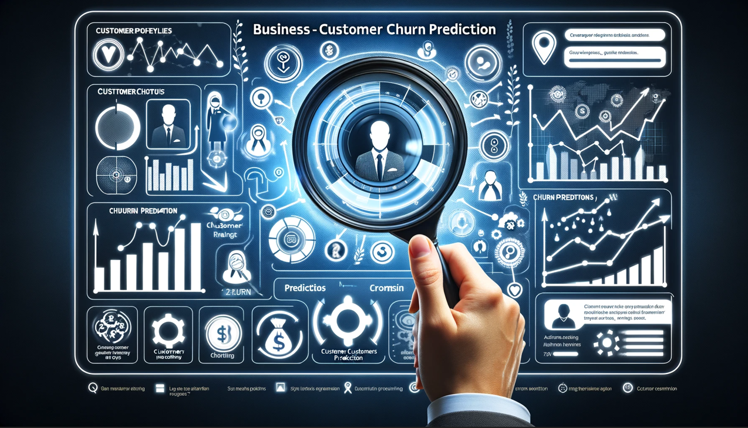
|Customer Churn Prediction
Task (T): Predicting which customers are likely to stop using services/products
Performance Metric (P): Precision and recall of churn predictions
Experience (E): Historical data on customer interactions, purchases, and retention

Slide 34
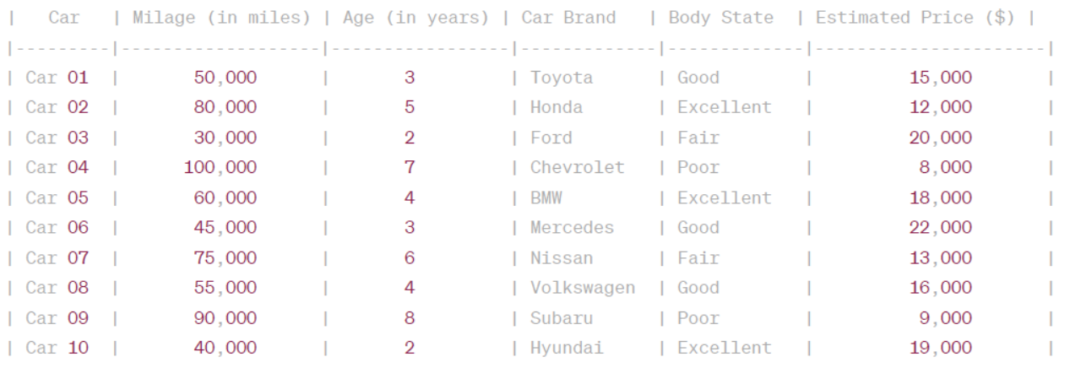
|ML Jargons

Slide 35
🧩 Core Terminology
🗂️ Training Set
  The collection of examples that the system uses to learn.
📄 Training Instance (Training Sample)
  Each individual example in the training set.
  ➡️ One email, one patient record, one car.
🏷️ Label
  The correct output associated with an instance.
  Example:📧 Spam📧 Not Spam

Slide 36
🧩 Core Terminology
🔢 Feature
An attribute with a value describing an instance.
Example: Mileage = 15,000
📦 Predictors
The set of features used to make a prediction.
Example (car price prediction):
🚗 Mileage
📆 Age
🏷️ Brand

Slide 37
🧩 Core Terminology
🎯 Performance Measure (P)
How well the model performs its task.
Example:
✅ Ratio of correctly classified emails
📈 Interpretation:
Higher performance → better learning from data.

Slide 38
|AI and the scientific method.
AI integrates naturally into science:
  👀 Observation → 📊 Data
  🔢 Numerical representation
  🤖 Model learning
  💡 Insight generation
  🧭 Decision or hypothesis guidance
Observation → Data → Learning → Insight → Decision
🧬Message: AI extends the scientific method—it does not replace it.

Slide 39
|Why AI works well in science
AI excels when:
  ❓Explicit equations are unknown or incomplete
  🌪️Systems are nonlinear or noisy
  🧠Relationships are high-dimensional
⚙️Message: AI is powerful where theory struggles or becomes intractable.

Slide 40
|Supervised Learning
What is Supervised Learning?
Supervised Learning is a type of machine learning where the model learns from labeled data.
📌 Each example includes:
Input (data)
Correct answer (label)

Slide 41
|Classification
What is Classification?
Classification is the task of assigning an item to a category based on its data.
  (e.g., spam vs. not spam)

Slide 42
|Classification
📧 Email Spam Filter
Incoming emails are classified as:
❌ Spam
✅ Not Spam
🏦 Loan Approval System
Loan applications are classified as:
✅ Approved
❌ Rejected
🩺 Disease Diagnosis
X-ray images are classified
Normal
Pneumonia
Tuberculosis
💬 Sentiment Analysis
Text data are classified as:
😊 Positive
😐 Neutral
😞 Negative

Slide 43
|Classification
🛒 Customer Segmentation
Customers are classified into different groups based on:
  Purchasing behavior
  Demographics
  Preferences
  to support targeted marketing.
💳 Credit Card Fraud Detection
Transactions are classified as:
❌ Fraudulent
✅ Legitimate
based on transaction history and user behavior.

Slide 44
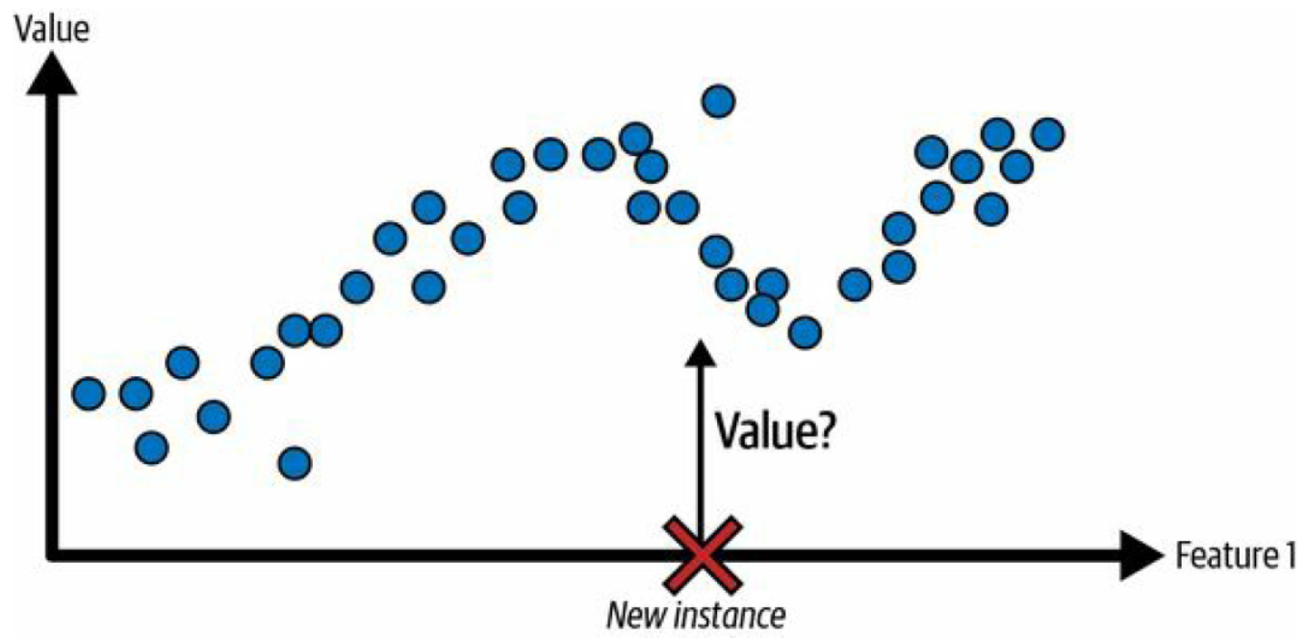
|Regression
What is Regression?
Regression is used to predict a continuous value (a number) based on one or more input variables.
📌 The predicted value can take any value within a range, not just fixed categories.

Slide 45
|What Is the Goal of Regression? 🎯
Model the relationship between:
  Predictors (input variables)
  Target (output value)
Use this relationship to:
  Predict outcomes for new, unseen data

Slide 46
|What Is the Goal of Regression? 🎯
Simple Examples 🌍
🏠 Predicting house prices
📈 Forecasting sales or demand
🌡️ Estimating temperature
🩺 Predicting disease risk score

Slide 47
|Regression
🩺 Life Expectancy Prediction
Estimating life expectancy or health outcomes based on:
  Diet
  Exercise
  Lifestyle choices
  Medical history
📦 Demand Forecasting
Predicting product demand in retail or manufacturing using:
Seasonality
Price
Consumer trends
⚡ Energy Consumption Analysis
Estimating energy usage of homes or buildings based on:
Building size
Location
Weather conditions
Occupancy

Slide 48
|Regression
🏦 Loan Amount Determination
Estimating the loan amount a person may receive based on:
Credit score
Income
Employment history
Past loan repayment behavior
🏃 Biometric Analysis (Sports Analytics)
Predicting athletic performance metrics such as:
Running speed
Jump height
based on biometric data.
🩺 Health Risk Assessment
Estimating the risk of developing medical conditions (e.g., diabetes or heart disease) using:
Health indicators
Lifestyle factors

Slide 49
|A Data-Driven Advisor
📖 Story Setup:
Imagine you're a university advisor trying to help students improve their performance. You’ve collected data from past students, and you're trying to understand:
What factors best predict a student's final exam score?

Slide 50
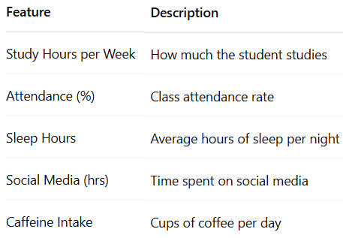
|A Data-Driven Advisor
📖 Story Setup
You’re a university advisor. You’ve noticed students struggle or succeed in different ways. You wonder: What factors really predict a student’s final exam score?
📊 Data Collected:

Slide 51
|A Data-Driven Advisor
Imagine you're a university advisor trying to help students improve their performance. You’ve collected data from past students, and you're trying to understand:
You want to answer questions like:
  If a student studies one extra hour per week, how much will their grade improve?
  Is attendance more important than sleep?
  Do social media hours really matter that much?

Slide 52
|Regression Model
$$Score=5+1.5×StudyHours+0.8×Attendance−0.2×SocialMedia+…$$
🔍 Interpretation of Weights:
  📈 Study Hours (+1.5): Every extra hour adds 1.5 points.
  📈 Attendance (+0.8): Attending class boosts scores.
  📉 Social Media (–0.2): Each hour scrolling drops scores a bit.

Slide 53
|Regression Model
🧠 Takeaway:
Some factors have a bigger impact, some have little or negative impact, and some may be statistically insignificant — that’s how we discover which features are truly important.
Regression helps us identify what really matters. Now, as an advisor, you’re not just guessing — you're guiding students with data!

Slide 54
|Optimizing a Web Application
📖 Story Setup:
You’re a software engineer on a high-traffic e-commerce website. Users are complaining that the site loads too slowly.
What factors are causing the delays?

Slide 55
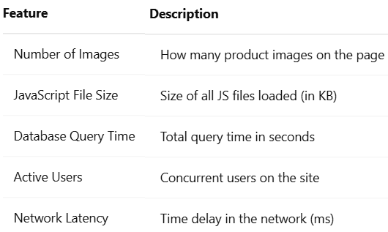
|Optimizing a Web Application
📖 Story Setup
You start logging data on thousands of page loads. For each request, you record?
📊 Data Collected:

Slide 56
|Regression Model
$$LoadTime = 0.5 + 0.1 × NumImages + 0.3 × JSSize + 0.7 × DBTime + 0.05 × Users$$
🔍 Interpretation of Weights:
  DBTime (+0.7): Most influential — optimize your queries!
  JSSize (+0.3): Reducing JS size helps.
  NumImages (+0.1): Images have minor effect.
  Users (+0.05): Slight effect from traffic..

Slide 57
|Regression Model
🧠 Takeaway:
Instead of guessing, you're now using data to focus engineering time where it matters most — improving database performance.

Slide 58
|Saving Lives with Data
🏥 Story Setup: Predicting Heart Disease Risk
You work with a hospital's cardiology team. They want to predict which patients are at high risk of heart disease — and prevent it before it's too late.

Slide 59
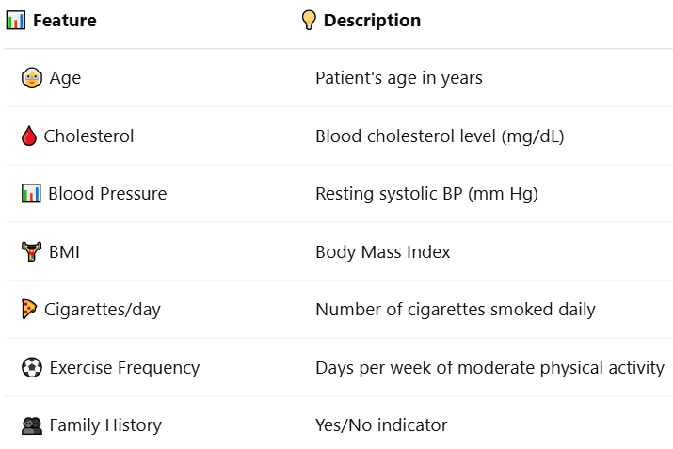
|Saving Lives with Data
📊 Data Collected:

Slide 60
|Regression Model
$$RiskScore = 10 + 0.8 × Age + 1.2 × Cholesterol + 0.9 × Cigarettes − 0.6 × Exercise$$
🔄 Interpretation of Coefficients:
  🔥 Cholesterol (+1.2): The most impactful — high levels sharply raise risk.
  💣 Cigarettes (+0.9): Smoking adds serious risk.
  🏃 Exercise (-0.6): More activity reduces risk.
  👵 Age (+0.8): Natural risk increase with age

Slide 61
|Regression Model
🧠 Takeaway:
With regression, doctors move from intuition to insight — enabling personalized care and smarter decisions to save lives.

Slide 62
|Predicting Height from a Femur Bone
Anthropologists can reconstruct information using partial human remains at burial sites ( مواقع الدفن)
After finding a femur (thighbone 🦴) عظمة الفخذ they can predict how tall an individual was
Sadly, this particular prediction equation had to be applied to bones found in mass graves ( مقابر جماعية) in Kosovo, to help identify Albanians who had been executed by Serbians in 1998

Slide 63
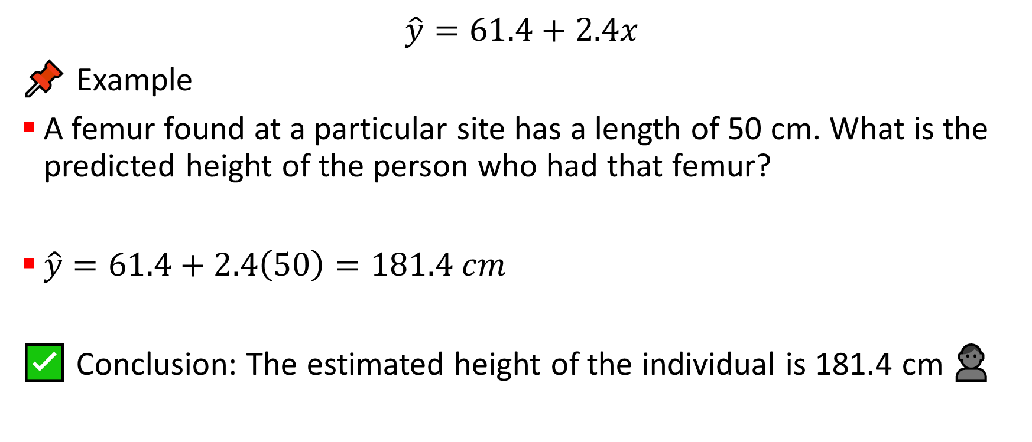
|Predicting Height from a Femur Bone
$$\hat{y}=61.4+2.4x$$
📌 Example
A femur found at a particular site has a length of 50 cm. What is the predicted height of the person who had that femur?
$\hat{y}=61.4+2.4\left(50\right)=181.4 cm$
✅ Conclusion: The estimated height of the individual is 181.4 cm 👤

Slide 64
|What is Regression?
Regression is a fundamental concept in statistics and machine learning used to model the relationship between a dependent variable (often called the output or target) and one or more independent variables (inputs or features).

Slide 65
|What is Regression?
🧠 In Simple Terms
Regression is like asking:
If I know X, can I predict Y?
Example:
🏠 Predicting house price based on size and location
👩‍🎓 Predicting student score from study hours

Slide 66
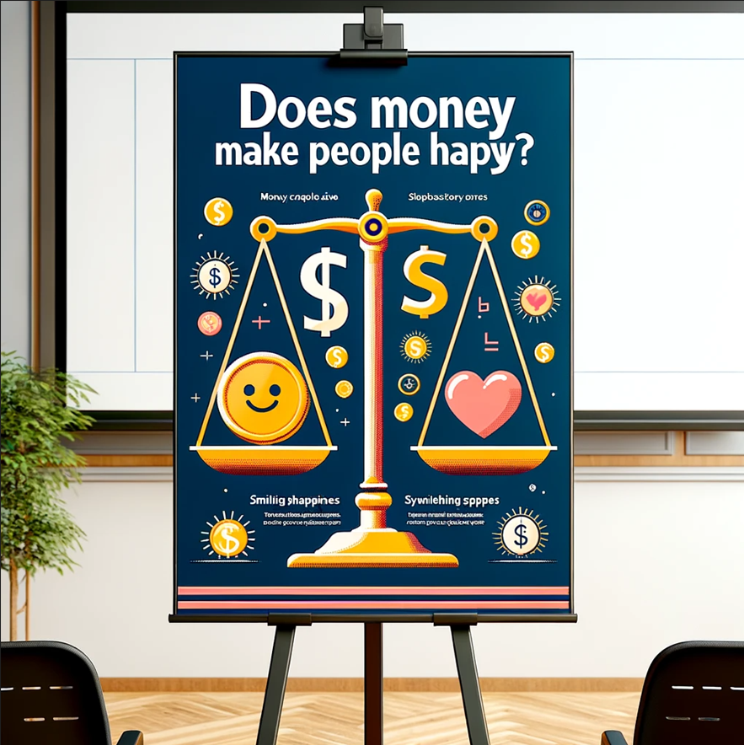
|Big Picture

Slide 67
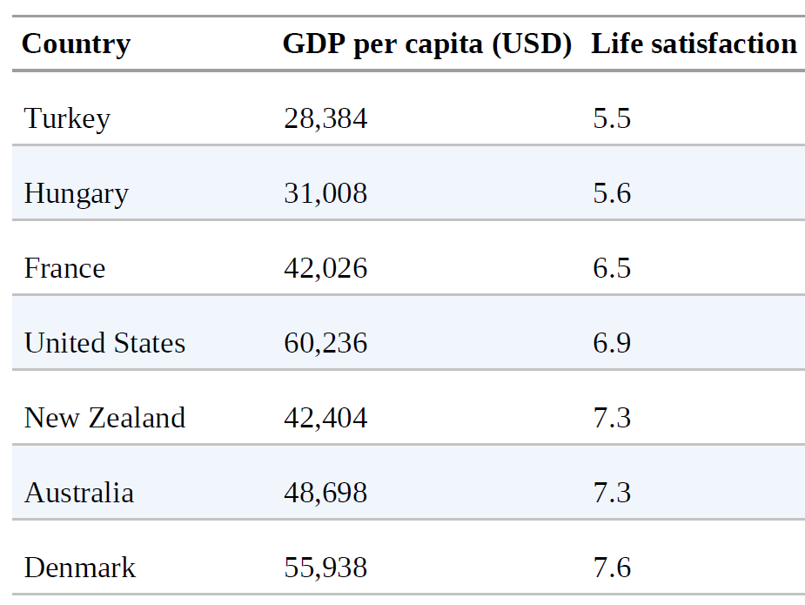
|Big Picture
Does money make people happy?
  Download the Better Life Index data from the OECD’s website https://www.oecdbetterlifeindex.org/
  and World Bank stats about gross domestic product (GDP) per capita الناتج المحلي الإجمالي للفرد https://ourworldindata.org/.
  Join the tables and sort by GDP per capita.

Slide 68
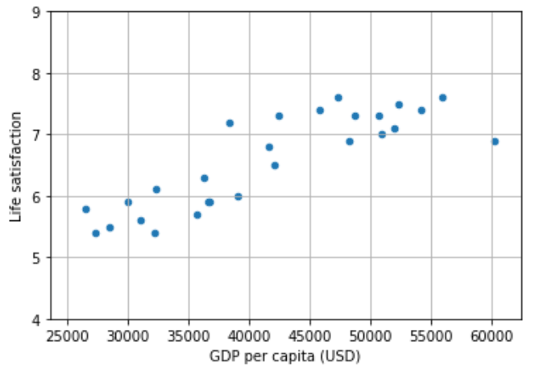
|Big Picture
There seems to be an emerging trend
  Data is noisy - partly random
  Life satisfaction goes up more or less linearly as the country’s GDP per capita increases.
  Model life satisfaction as a linear function of GDP per capita. This step is called model selection.

Slide 69
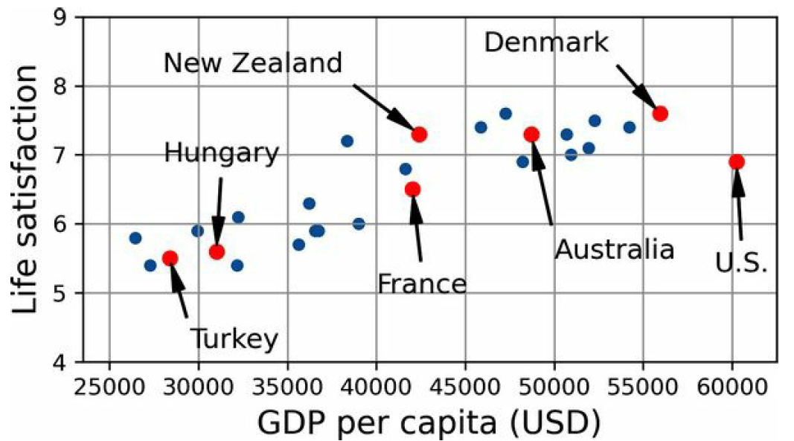
|Big Picture

Slide 70
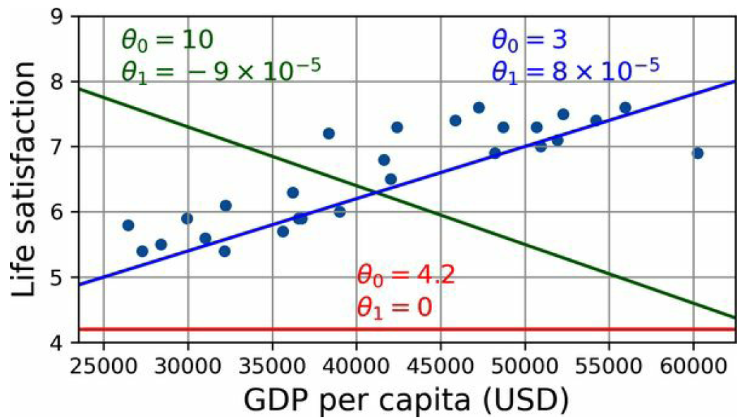
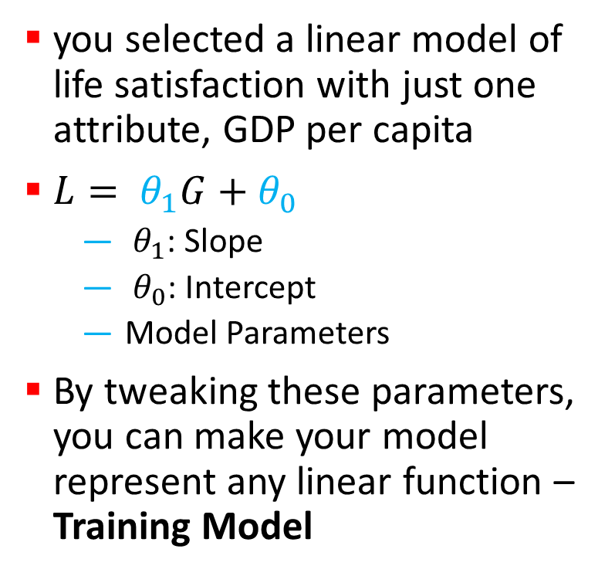
|Big Picture
you selected a linear model of life satisfaction with just one attribute, GDP per capita
$L= θ_{1}G+θ_{0}$
  $θ_{1}$: Slope
  $θ_{0}$: Intercept
  Model Parameters
By tweaking these parameters, you can make your model represent any linear function – Training Model

Slide 71
|Big Picture
How can you know which values will make your model perform best?
  Specify a performance measure.
  Utility function (or fitness function) that measures how good your model is
  you can define a cost function that measures how bad it is
  For linear regression problems, people typically use a cost function that measures the distance between the linear model’s predictions and the training examples;
  The objective is to minimize this distance
  This is where the linear regression algorithm comes in:
  you feed it your training examples, and it finds the parameters that make the linear model fit best to your data

Slide 72
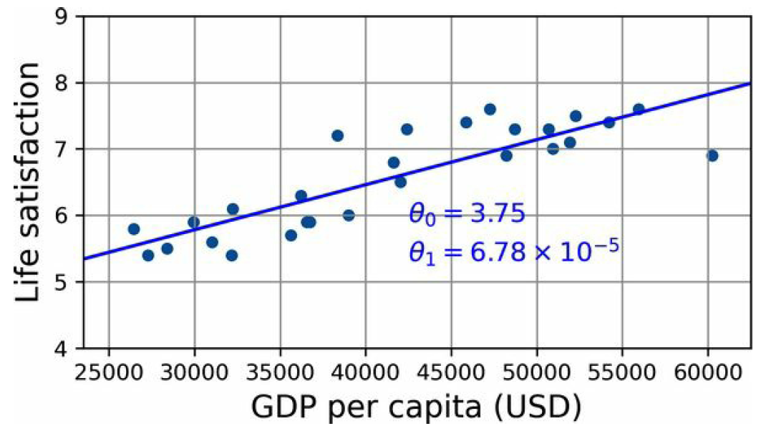

|Big Picture
$L= θ_{1}G+θ_{0}$
$L=6.78×{10}^{−5 }G+3.75$

Slide 73
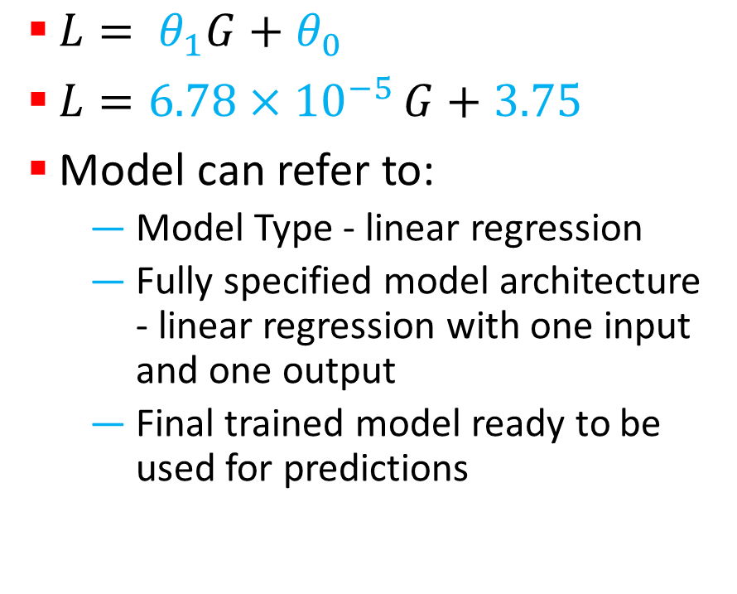
|Big Picture
$L= θ_{1}G+θ_{0}$
$L=6.78×{10}^{−5 }G+3.75$
Model can refer to:
  Model Type - linear regression
  Fully specified model architecture - linear regression with one input and one output
  Final trained model ready to be used for predictions

Slide 74
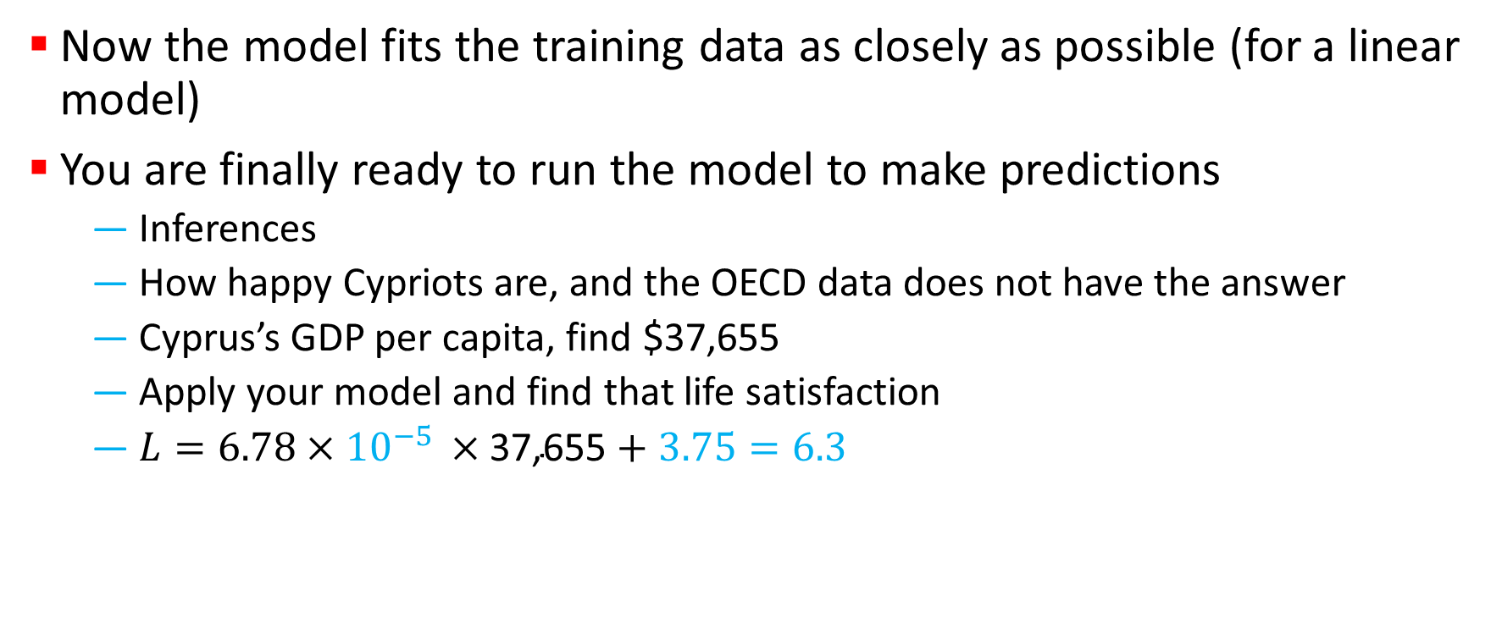
|Big Picture
Now the model fits the training data as closely as possible (for a linear model)
You are finally ready to run the model to make predictions
  Inferences
  How happy Cypriots are, and the OECD data does not have the answer
  Cyprus’s GDP per capita, find $37,655
  Apply your model and find that life satisfaction
  $L=6.78×{10}^{−5 }×\text{37,}\text{655}+3.75=6.3$

Slide 75
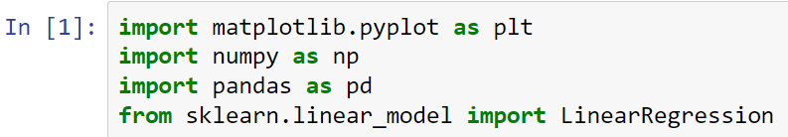
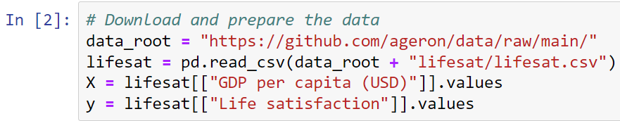
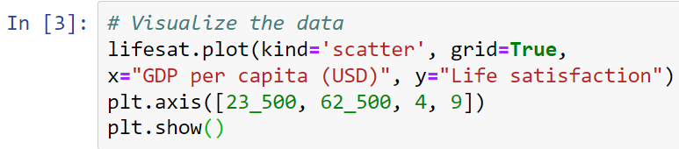
|Big Picture

Slide 76


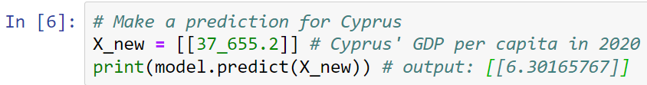
|Big Picture

Slide 77
|Big Picture
If all went well, your model will make good predictions. If not, you may need to:
  Use more attributes (employment rate, health, air pollution, etc.),
  Get more or better-quality training data, or
  Perhaps select a more powerful model (e.g., a polynomial regression model).

Slide 78
|Project Overflow
You studied the data.
You selected a model.
You trained it on the training data (i.e., the learning algorithm searched for the model parameter values that minimize a cost function).
Finally, you applied the model to make predictions on new cases (this is called inference), hoping that this model will generalize well.

Slide 79
|Main Challenges
Since your main task is to select a model and train it on some data, the two things that can go wrong are:
  bad model and
  bad data

Slide 80
|The Biggest Challenge in AI: Data 🚨📊
“Garbage In → Garbage Out”
AI systems learn only from the data they receive.
If the data is poor, the results will be poor—no matter how advanced the model is.

Slide 81
1️⃣Not Enough or Wrong Data 📉
Insufficient Data
  Too few examples to learn reliable patterns.
Non-Representative Training Data
  Data does not reflect the real world the system will face.
Sampling Noise
  Random errors or fluctuations hide the true signal.
Sampling Bias
  Certain groups or conditions are over- or under-represented.
🧠 Result: The model learns the wrong patterns.

Slide 82
|Sampling Bias — A Classic Example
The Literary Digest Poll (1936)
📖 The Literary Digest magazine tried to predict the 1936 U.S. presidential election between:
Franklin D. Roosevelt (Democrat, incumbent)
Alf Landon (Republican)
The magazine was famous—it had correctly predicted three previous elections.

Slide 83
|What did they do? 📬
Sent 10 million questionnaires
Sampling frame built from:
  📞 Telephone directories
  🚗 Automobile registrations
  ⛳ Country club memberships
2.3 million people responded (huge sample!)
📊 Prediction:
Landon would win with 57% of the vote.
❌ Reality:
Landon got 36%, and Roosevelt won by a landslide.

Slide 84
|What went wrong? 🚨
Sampling Bias (Undercoverage)
Year: 1936 — Great Depression
People with:
  Cars
  Telephones
  Country club memberships
  were mostly wealthy
Wealthy voters tended to support Republicans
➡️ Large parts of the population were never sampled.

Slide 85
|What went wrong? 🚨
Nonresponse Bias
7.7 million people did NOT respond
Those unhappy with the current president were more likely to reply
➡️ Respondents were not representative of voters.

Slide 86
|A Powerful Contrast 🧠✨
At the same time, a young pollster named George Gallup:
Surveyed only 50,000 people
Used better sampling methods
Correctly predicted Roosevelt’s victory
📌 The Gallup Organization still exists today.
📉 The Literary Digest went out of business soon after.

Slide 87
|The Big Lesson 🎯
❌ Big data does NOT fix bad data.
❌ Large samples do NOT guarantee correct results.
✅ How data is collected matters more than how much data you have.
A biased sample, even if it has millions of records, leads to biased conclusions.

Slide 88
2️⃣Poor Data Quality 🧾⚠️
Poor-Quality Data
Errors, duplicates, inconsistent measurements.
Incomplete Data (Missing Values)
Important information is absent or unknown.
Outdated Data
Data no longer matches current conditions or behavior.
🧠 Result: Predictions become unreliable or misleading.

Slide 89
3️⃣Irrelevant or Misleading Features 🧩❌
Irrelevant Features
Variables that add noise instead of information.
Features that:
  Do not affect the target
  Confuse the learning process
🧠 Result: The model focuses on what does not matter.

Slide 90
Key Takeaway 🎯
AI does not fail because models are weak.
AI fails because data is insufficient, biased, noisy, or outdated.
Better data beats better algorithms.
Before asking “Which model should we use?”,
we must ask “Can we trust our data?”

Slide 91
|Why Optimization Appears in Machine Learning 🎯
In machine learning, we do not guess models—we optimize them.
Models have parameters
Parameters affect predictions
Predictions produce errors
👉 Learning means reducing error.
Key idea:
Training a model = searching for parameters that minimize error.

Slide 92
|Error as a Scientific Quantity 📉
Every model makes mistakes.
  📏 Error measures how far predictions are from reality
  🔻 Lower error = better model
  🔺 Higher error = poorer model
In regression:
Error = difference between predicted and actual values
Message:
Machine learning turns learning into a quantitative optimization problem.

Slide 93
|Optimization: the core idea ⚙️
Optimization means:
Defining what “good” means (error or loss)
Searching for parameters that improve performance
In practice:
  There is rarely one perfect solution
  We search for good enough solutions
Key sentence:
Optimization is the engine that drives learning.

Slide 94
|Why optimization is hard 🧩
Optimization becomes difficult when:
🔢 Many parameters exist
🌪️ Data is noisy
🧠 The error surface is complex
⛰️ Many local optima appear
Message:
Exact solutions are often impossible or impractical.

Slide 95
|Heuristics: practical problem solving 🛠️
When exact optimization fails, we use heuristics.
Heuristics are:
Practical rules of thumb
Fast, approximate methods
Not guaranteed to be optimal
Scientific analogy:
Heuristics in AI are like approximations in physics.
They trade perfection for feasibility.

Slide 96
|From heuristics to metaheuristics
Some problems are too complex for problem-specific heuristics.
Metaheuristics:
  General-purpose search strategies
  Applicable to many problems
  Focus on exploration and exploitation
Message:
Metaheuristics guide how we search, not what we search.

Slide 97
|Inspiration behind metaheuristics 🌱
Metaheuristics are often inspired by:
🧬 Evolution (natural selection)
🐜 Collective behavior
🌊 Physical processes
Key idea:
Nature solves complex problems without exact equations.

Slide 98
|Genetic Algorithm: the idea 🧬
A Genetic Algorithm (GA) is an optimization method inspired by evolution.
It operates on:
  A population of candidate solutions
  Not a single solution
Each candidate represents:
  A possible set of parameters
  A possible model configuration

Slide 99
|How a Genetic Algorithm works
A GA follows a simple cycle:
🎲 Initialize a population (random solutions)
📊 Evaluate fitness (how good each solution is)
🧬 Select better solutions
🔀 Combine solutions (crossover)
🎯 Introduce variation (mutation)
🔁 Repeat until improvement stabilizes
Message:
Better solutions survive and evolve.

Slide 100
|Fitness: connecting GA to machine learning 🎯
Fitness = performance measure
In ML, fitness may be:
Prediction accuracy
Error reduction
Model performance
Key connection:
Genetic algorithms optimize the same objective as learning models—performance.

Slide 101
|Why use Genetic Algorithms? 🤔
Genetic Algorithms are useful when:
The search space is large
The problem is nonlinear
Gradients are unavailable or unreliable
Multiple good solutions may exist
Message:
GA is powerful when classical optimization struggles.

Slide 102
|Genetic Algorithms in scientific applications 🔬
GA can be used for:
Parameter optimization
Feature selection
Model tuning
Engineering design
Key insight:
GA helps search, not decide meaning.

Slide 103
|Connecting back to science 🧠🔬
Models describe phenomena
Errors quantify mismatch
Optimization improves models
Heuristics make learning practical
Genetic algorithms explore complex spaces
Core message:
Optimization is how machines learn; interpretation is how scientists understand.

Slide 104
|Closing this section 🎯
Genetic Algorithms show us that:
  Learning is a search process
  Nature-inspired strategies can solve hard problems
  There is no free lunch in optimization
Final sentence:
In machine learning, we don’t find perfect solutions—we evolve better ones.

Slide 105
👉 The Metaheuristic Optimization Loop
Despite their different inspirations, all metaheuristic algorithms follow the same logic.
  They differ in how they do it, not what they do.
Core loop:
Initialize → Evaluate → Update → Repeat

Slide 106
|Step 1: Initial solution population 🎲
Every metaheuristic begins with candidate solutions.
🧬 A population (or a set) of solutions
🎯 Each solution represents a possible answer
🎲 Usually initialized randomly
Key idea:
We start with diversity, not perfection.
This prevents early bias and encourages exploration.

Slide 107
|What is a “solution” really? 🧩
In optimization, a solution may represent:
📐 Model parameters
🔢 Feature subsets
⚙️ Design configurations
Connection to ML:
Each solution = one possible model or configuration.

Slide 108
|Step 2: Fitness evaluation 📊
Each solution is evaluated using a fitness function.
🎯 Fitness measures solution quality
📉 Often related to error or performance
🔍 Provides feedback to guide search
Key principle:
Fitness defines what “good” means.
Without fitness, there is no learning.

Slide 109
|Fitness is not truth ⚠️
Important scientific warning:
Fitness reflects objectives, not reality
A good score does not guarantee understanding
Poorly defined fitness leads to misleading solutions
Message:
Optimization follows the metric you choose—not the phenomenon itself.

Slide 110
|Step 3: Updating solutions 🔄
After evaluation, solutions are updated.
This update balances two opposing forces:
  🔎 Exploration: searching new regions
  🎯 Exploitation: refining good solutions
Key tension:
Too much exploration → slow progress
Too much exploitation → premature convergence

Slide 111
|Exploration 🧭
Exploration means:
Trying new, unseen regions
Escaping local optima
Maintaining diversity
Scientific analogy:
Exploring new hypotheses, even risky ones.

Slide 112
|Exploitation 🎯
Exploitation means:
Improving promising solutions
Refining known good regions
Converging toward better performance
Scientific analogy:
Refining a promising theory with more experiments.

Slide 113
|The art of balance ⚖️
Effective metaheuristics manage:
When to explore
When to exploit
How much randomness to allow
Key insight:
Optimization is not about speed—it’s about balance.

Slide 114
|Step 4: Iteration 🔁
The process repeats:
  Evaluate → Update → Evaluate again
Over time:
  Poor solutions disappear
  Better solutions dominate
  Performance improves gradually
Message:
Learning emerges through repetition.

Slide 115
|When does the process stop? ⏹️
Metaheuristic optimization stops when:
🕒 A maximum number of iterations is reached
📉 Improvement becomes negligible
🎯 Performance is satisfactory
Key idea:
Optimization stops when progress no longer justifies cost.

Slide 116
|One framework, many algorithms 🌐
Different metaheuristics differ mainly in:
How solutions are updated
How exploration is encouraged
How exploitation is enforced
But all share the same backbone:
  Population
  Fitness
  Update
  Iteration

Slide 117
|Genetic Algorithm as an example 🧬
In Genetic Algorithms:
🧬 Population = chromosomes
🎯 Fitness = performance score
🔀 Update = selection, crossover, mutation
🔁 Iteration = generations
Message:
GA is one instantiation of the general metaheuristic framework.

Slide 118
|Trending Metaheuristic Algorithms
Metaheuristic Algorithm | Core Inspiration | Exploration Operator 🔎 | Exploitation Operator 🎯
Genetic Algorithm (GA) | Biological evolution | Mutation (random gene changes) | Selection + Crossover
Particle Swarm Optimization (PSO) | Social behavior (birds/fish) | Random velocity component | Attraction toward global & personal best
Differential Evolution (DE) | Population differences | Vector-based mutation | Greedy selection
Grey Wolf Optimizer (GWO) | Wolf hunting hierarchy | Position diversification | Leader-guided convergence (α, β, δ)
Whale Optimization Algorithm (WOA) | Bubble-net hunting strategy | Random/spiral movement | Shrinking encircling mechanism

Slide 119
|The future of AI in sciences
Future science will involve:
  🚀 AI-driven discovery
  🧪 Automated experimentation
  🔗 Integration of data and theory
🔮Message: AI will reshape how discoveries are made, not who makes them.

Slide 120
|Closing
Artificial Intelligence is:
  🛠️ A tool
  🤝 A collaborator
  🔬 A scientific instrument
✨ Final message:
The future of science belongs to those who can think with machines, not against them.

