Slide 1
Active Learning
Mostafa A. Elhosseini
Prof. at Mansoura University
https://youtube.com/drmelhosseini

Slide 2
| Intro...
Unlike robots in the movies, most of today’s artificial intelligence (AI) can not learn by itself; instead, it relies on intensive human feedback
Probably 90% of machine learning applications today are powered by supervised machine learning
An autonomous vehicle can drive you safely down the street because humans have spent thousands of hours telling it when its sensors are seeing a pedestrian, moving vehicle, lane marking, or other relevant object
Your in-home device knows what to do when you say “Turn up the volume” because humans have spent thousands of hours telling it how to interpret different commands
Compared with the past, our intelligent devices are learning less from programmers who are hard coding rules and more from examples and feedback given by humans who do not need to code. These human-encoded examples—the training data

Slide 3
| Intro...
What are the right ways for humans and machine learning algorithms to interact to solve problems
Annotation and active learning are the cornerstones of human-in-the-loop machine learning

Slide 4
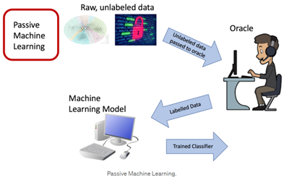
| Passive Learning
Passive learning is the standard framework in which a large quantity of labeled data is passed to the algorithm, requires significant effort in labeling the entire set of data

Slide 5
| Labeling Data
Crowdsourcing is the practice of obtaining information or input into a task or project by enlisting the services of many people, either paid or unpaid, typically via the internet. crowdsourcing is less expensive than hiring a professional translator
The motivation for active learning is a scenario in which we have a large pool of unlabelled data
In this case, rather than randomly selecting instances to label, it is often preferable to perform active learning where human experts interact with the learning algorithm, providing labels for specific instances when the algorithm requests them

Slide 6
| Motivation
One of the more time-consuming tasks in passive learning is collecting labelled data. In many settings, there can be limiting factors that hamper gathering large amounts of labelled data
Let's take the example of studying pancreatic cancer. You might want to predict whether a patient will get pancreatic cancer, however, you might only have the opportunity to give a small number of patients further examinations to collect features, etc.
In this case, rather than selecting patients at random, we can select patients based on certain criteria
  An example criteria might be if the patient drinks alcohol and is over 40 years. This criteria does not have to be static but can change depending on results from previous patients

Slide 7
| Motivation
For example, if you realised that your model is good at predicting pancreatic cancer for those over 50 years, but struggle to make accurate prediction for those between 40-50 years, this might be your new criteria
The process of selecting these patients (or more generally instances) based upon the data we have collected so far is called active learning

Slide 8
| Motivation
Data does not always come with the label of interest for the task at hand
It is often a very cumbersome task to (correctly) label the data
Academic machine learning researchers have tended to keep the datasets constant and evaluated their research only in terms of different algorithms
  It is more common in industry to improve model performance by annotating more training data. Especially when the nature of the data is changing over time (which is also common),
One of the more time-consuming tasks in passive learning is collecting labelled data. In many settings, there can be limiting factors that hamper gathering large amounts of labelled data

Slide 9
| Motivation
humans who provide the labels can make errors, and overcoming these errors requires surprisingly sophisticated statistics
  Human errors in training data can be more or less important, depending on the use case
  Identify broad trends in consumer sentiment, it probably won’t matter whether errors propagate from 1% bad training data
  powers an autonomous vehicle doesn’t see 1% of pedestrians due to errors propagated from bad training data, the result will be disastrous
  Some algorithms can handle a little noise in the training data, and random noise even helps some algorithms become more accurate by avoiding overfitting. But human errors tend not to be random noise; therefore, they tend to introduce irrecoverable bias into training data

Slide 10
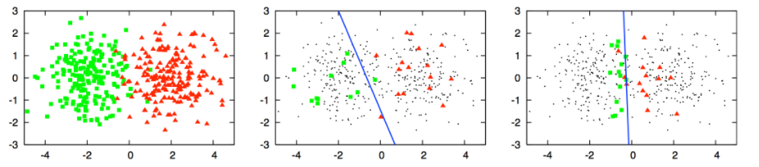
| Motivation through Example
you have two clusters, those coloured green and those coloured red
This is a classification task and you would like to create a 'decision boundary'
However, you can assume that you do not know the labels (red or green) of the data points, but trying to find the label for each of them would be very expensive

Slide 11
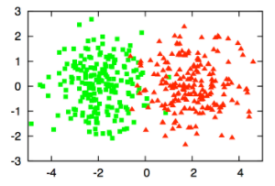
| Motivation through Example
you would want to sample a small subset of points and find those labels and use these labelled data points as your training data for a classifier

Slide 12
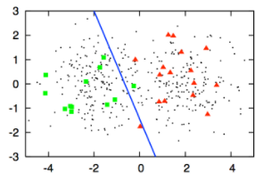
| Motivation through Example
logistic regression is used to classify the shapes by first randomly sampling a small subset of points and labelling them.
However, you see that the decision boundary created using logistic regression (the blue line) is sub-optimal.
This line is clearly skewed away from the red data points and into the green shapes area.
This means that there will be many green data points that will be labelled incorrectly as red.
This skew is due to the poor selection of data points for labelling

Slide 13
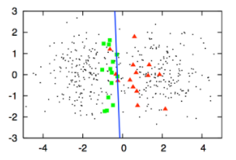
| Motivation through Example
logistic regression is used again, but this time, you selected a small subset of points using an active learning query method.
This new decision boundary is significantly better as it better separates both colours.
This improvement comes from selecting superior data points so that the classifier was able to create a very good decision boundary

Slide 14
| Active Learning
Active learning is a machine learning framework in which the learning algorithm can interactively query a user (teacher or oracle) to label new data points with the true labels
Active learning is the process of deciding which data to sample for human annotation
The process of active learning is also referred to as optimal experimental design
By using active learning, we can selectively leverage a system like crowdsourcing to ask human experts to selectively label some items in the data set, but not have to label the entirety
Most research papers on active learning focus on the number of training items, but speed can be an even more important factor in many cases

Slide 15
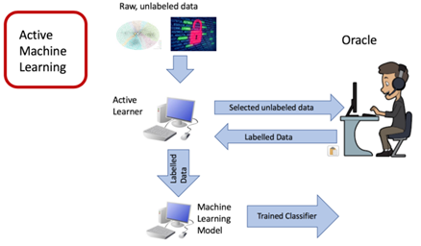
| Active Learning
The algorithm iteratively selects the most informative examples based on some value metric and sends those unlabelled examples to a labeling oracle, who returns the true labels for those queried examples back to the algorithm

Slide 16
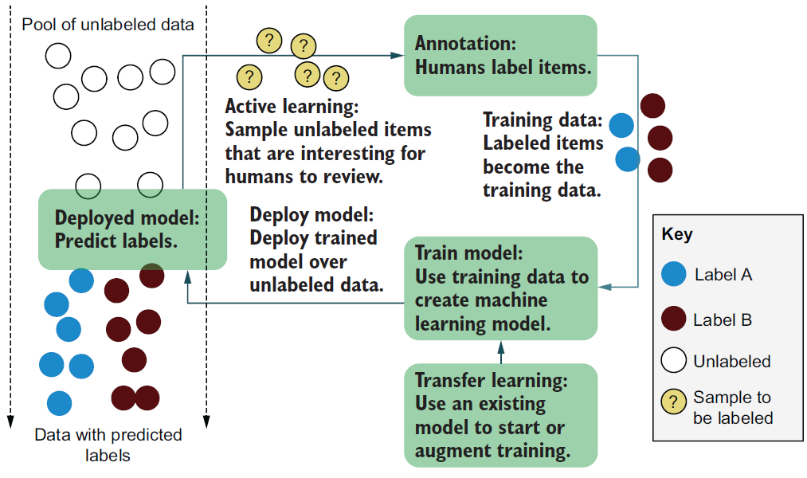
| Active Learning
sampling the right data to label,
Using that data to train a model, and
using that model to sample more data to annotate

Slide 17
| Active Learning
Active learning is motivated by the understanding that not all labeled examples are equally important
The active learning framework reduces the selection of data to a problem of determining which are the most informative data points in the set
Active learning is considered to be a semi-supervised learning method, between unsupervised being using 0% of the learning examples and fully supervised being using 100% of the examples
By iteratively increasing the size of our labeled training set, we can achieve greater performance near the fully supervised performance

Slide 18
| Annotation
Annotation is the process of labeling raw data so that it becomes training data for machine learning.
Most data scientists will tell you that they spend much more time curating and annotating datasets than they spend building the machine learning models.
Quality control for human annotation relies on more complicated statistics than most machine learning models do

Slide 19
| Annotation
An annotation process can be simple: label social media posts about a product as positive, negative, or neutral to analyze broad trends in sentiment about that product
  build and deploy an HTML form
An annotation process can also be complicated: If you want to label every object in a video with a bounding box
  need a graphical interface that allows annotators to draw those boxes, and
  a good user experience might take months of engineering hours to build

Slide 20
| How it works - Active Learning process is iterative
The model is trained on the labeled instances gathered so far, and this model is used to make predictions on all the unlabeled instances
The instances for which the model is most uncertain (i.e. when its estimated probability is lowest) are given to the expert to be labeled
You iterate this process until the performance improvement stops being worth the labelling effort
Other strategies include labeling the instances that would result in the largest model change - largest drop in model validation error, or the instances that different models disagree on (SVM or a Random forest)

Slide 21
| How it works - Active Learning process is iterative
The model is trained on the labeled instances gathered so far, and this model is used to make predictions on all the unlabeled instances
The instances for which the model is most uncertain (i.e. when its estimated probability is lowest) are given to the expert to be labeled
You iterate this process until the performance improvement stops being worth the labelling effort
Other strategies include labeling the instances that would result in the largest model change - largest drop in model validation error, or the instances that different models disagree on (SVM or a Random forest)

Slide 22
| Scenarios
In active learning, there are typically three scenarios or settings in which the learner will query the labels of instances.
The three main scenarios that have been considered in the literature are:
  Membership Query Synthesis
  Stream-Based Selective Sampling:
  Pool-Based sampling:

Slide 23
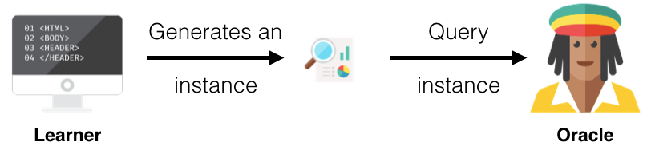
| Membership Query Synthesis
The learner generates / constructs an instance (from some underlying natural distribution).
  For example, if the data is pictures of digits, the learner would create an image that is similar to a digit (it might be rotated or some piece of the digit excluded) and this created image is sent to the oracle to label.

Slide 24
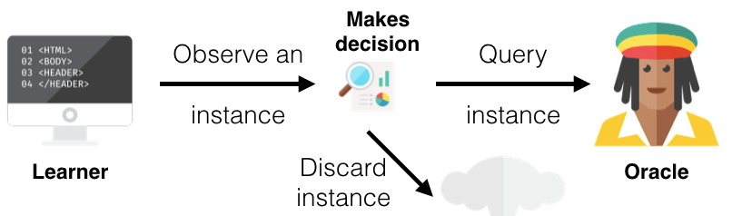
| Stream-Based Selective Sampling
you make the assumption that getting an unlabelled instance is free
select one image from the set of unlabelled images, determine whether it needs to be labelled or discarded, and then repeat with the next imagine

Slide 25
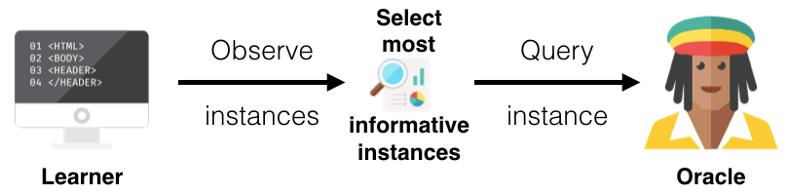
| Pool-Based Sampling
This setting assumes that there is a large pool of unlabelled data
Instances are then drawn from the pool according to some informativeness measure.
This measure is applied to all instances in the pool (or some subset if the pool is very large) and then the most informative instance(s) are selected.
This is the most common scenario in the active learning community
I.e. all the unlabelled images of digits will be ranked and then the best (most informative) instance(s) will be selected and their labels requested

Slide 26
| How Active Learning was able to select good points

Slide 27
| Query Strategy
All active learning scenarios require some sort of informativeness measure of the unlabelled instances.
Three popular approaches for querying instances under the common topic called uncertainty sampling due to its use of probabilities are covered
  Least Confidence (LC)
  Margin Sampling
  Entropy Sampling

Slide 28
| Query Strategy
This table shows two data points (instances) and the probabilities that each instance has each label. The probability d₁ has label A, B and C is 0.9, 0.09 and 0.01 respectively and 0.2, 0.5 and 0.3 for d₂
Instances | Label A | Label B | Label C
d1 | 0.9 | 0.09 | 0.01
d2 | 0.2 | 0.5 | 0.3

Slide 29
| Least Confidence
The learner selects the instance for which it has the least confidence in its most likely label.
Looking at the table, the leaner is pretty confident about the label for d1, since it thinks it should be labelled A with probability 0.9, however, it is less sure about the label of d2 since its probabilities are more spread and it thinks that it should be labelled B with a probability of only 0.5. Thus, using least confidence, the learner would select d2 to query it's actual label
Instances | Label A | Label B | Label C
d1 | 0.9 | 0.09 | 0.01
d2 | 0.2 | 0.5 | 0.3

Slide 30
| Margin Sampling
The shortcoming of the LC strategy, is that it only takes into consideration the most probable label and disregards the other label probabilities.
The margin sampling strategy seeks to overcome this disadvantage by selecting the instance that has the smallest difference between the first and second most probable labels. Looking at d1, the difference between its first and second most probable labels is 0.81 (0.9 - 0.09) and for d2 it is 0.2 (0.5 - 0.3). Hence, the learner will select d2 again
Instances | Label A | Label B | Label C
d1 | 0.9 | 0.09 | 0.01
d2 | 0.2 | 0.5 | 0.3

Slide 31
| Entropy Sampling
In order to utilize all the possible label probabilities, you use a popular measure called entropy.
entropy as an uncertainty measure. This way we can measure the amount of information that the probability distribution over all the labels withholds. And we pick that entry which maximizes this information
The entropy formula is applied to each instance and the instance with the largest value is queried.
Using our example, d1 has a value of 0.155 while d2's value is 0.447 and so the learner will select d2 once again
Instances | Label A | Label B | Label C
d1 | 0.9 | 0.09 | 0.01
d2 | 0.2 | 0.5 | 0.3

Slide 32
| Random Sampling
You should always annotate some amount of random data to gauge the accuracy of your model and compare your active learning strategies with a baseline of randomly selected items

Slide 33
| Uncertainty Sampling - Exploitation
Uncertainty sampling is the set of strategies for identifying unlabeled items that are near a decision boundary in your current machine learning model. If you have a binary classification task, these items will have close to a 50% probability of belonging to either label; therefore, the model is called uncertain or confused
These items are most likely to be wrongly classified, so they are the most likely to result in a label that differs from the predicted label, moving the decision boundary after they have been added to the training data and the model has been retrained

Slide 34
| Diversity sampling - exploration
Diversity sampling is the set of strategies for identifying unlabeled items that are underrepresented or unknown to the machine learning model in its current state.
The items may have features that are rare in the training data, or they might represent real world demographics that are currently under-represented in the model
Although the term uncertainty sampling is widely used, diversity sampling goes by different names in different fields, such as representative sampling, stratified sampling, outlier detection, and anomaly detection

Slide 35
| Combining Uncertainty sampling and Diversity sampling
Uncertainty sampling and diversity sampling have shortcomings in isolation
Uncertainty sampling might focus on one part of the decision boundary
  Diversity sampling might focus on outliers that are a long distance from the boundary.
So the strategies are often used together to find a selection of unlabeled items that will maximize both uncertainty and diversity

Slide 36
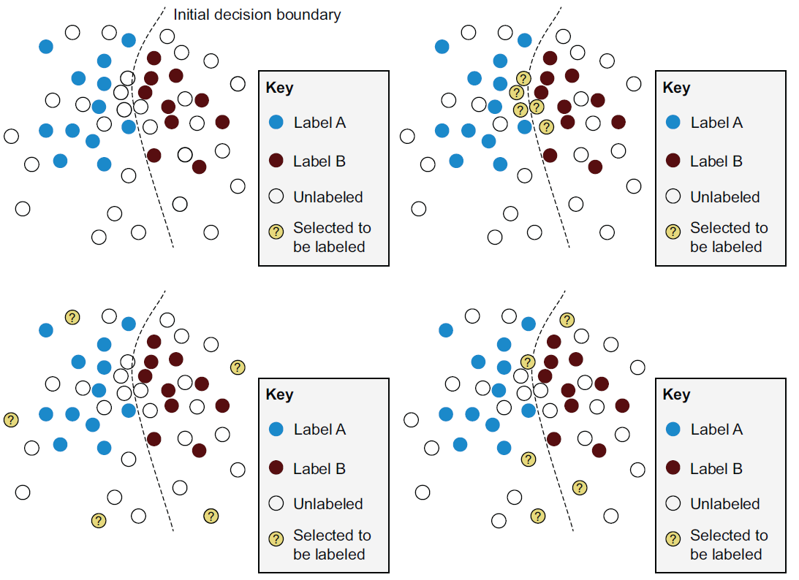
| Combining Uncertainty sampling and Diversity sampling
Top right: uncertainty sampling
These items are the most likely to be wrongly predicted, and therefore, the most likely to get a label
that moves the decision boundary
If all the uncertainty is in one part of the problem space, however, giving these
items labels will not have a broad effect on the model

Slide 37
| Combining Uncertainty sampling and Diversity sampling
Bottom left: diversity sampling
This active learning strategy is effective for selecting unlabeled items in different parts of the problem space.
If the diversity is away from the decision boundary, however, these items are unlikely to be wrongly predicted, so they will not have a large effect on the model when a human gives them a label that is the same as the model predicted

Slide 38
| Combining Uncertainty sampling and Diversity sampling
Bottom right: diversity sampling
One possible result from combining uncertainty sampling and diversity sampling.
When the strategies are combined, items are selected that are near diverse sections of the decision boundary. Therefore, we are optimizing the chance of finding items that are likely to result in a changed decision boundary

Slide 39
| Putting It All Together
Step 0: Gather Data: it is important to ensure that the dataset you gather is representative of the true distribution of the data
Try to avoid a lot of skewed data. In reality it is impossible to have a totally representative sample due to limitations such as legal, time or availability
In this example, you will have the following 5 data points. Feature A and Feature B represent some features that a data point might have. It is important to note that the data we gather is unlabelled
Instances | Feature A | Feature B
d1 | 10 | 0
d2 | 4 | 9
d3 | 8 | 5
d4 | 3 | 3
d5 | 5 | 5

Slide 40
| Putting It All Together
Step 01: Split into Seed and Unlabelled Datasets: Split our data into a very small dataset which we will label and a large unlabelled dataset. In active learning terminology, we call this small labelled dataset the seed. There is no set number or percentage of the unlabelled data that is typically used.
Once you have set aside the data that you will use for the seed, you should label them
N.B. in most of the literature, researchers do not use an oracle or an expert to label these instances. Typically, they get a dataset that is fully labelled and use a small amount for the seed (since they already have the label) and use the rest as if they are unlabelled. Whenever the learner selects an instance to query the oracle with, they simply just look up the label for the instance

Slide 41
| Putting It All Together
Continuing with the example, you select two instances for the seed, d1 and d3. The possible labels in this case are 'Y' and 'N'
Instances | Feature A | Feature B | Label
d1 | 10 | 0 | Y
d3 | 8 | 5 | N
Instances | Feature A | Feature B
d2 | 4 | 9
d4 | 3 | 3
d5 | 5 | 5

Slide 42
| Putting It All Together
Step 02:Train the model: After splitting our data, you use the seed to train our learner like a normal machine learning project
you would use models that give a probabilistic response to whether an instance has a particular label, as you use these probabilities for the query strategies
use any classifier you want and you will train on your two labelled instances

Slide 43
| Putting It All Together
Step 03: Choose unlabelled instances: Once you have trained your learner, you are now ready to select an instance or instances to query.
You would have to determine the type of scenario your would like to use (that is, Membership Query Synthesis, Stream-Based Selective Sampling or Pool-Based sampling) and the query strategy
You will use pool-based sampling with a batch size of 2. This means at each iteration, you will select two instances from your unlabelled dataset and then you add these instances to your labelled dataset.
You use least confidence to select your instances. Your learner selects d2 and d4 whose queried labels are 'Y' and 'N', respectively

Slide 44
| Putting It All Together
Step 04 Stopping Criteria: Repeat steps 2 and 3 until some stopping criteria.
One stopping criteria could be the number of instances queried, another could be the number of iterations of steps 2 and 3, you can also stop after the performance does not improve significantly above a certain threshold
You can also have a separate test dataset that you evaluate your learner on and record its performance. This way, you can see how your performance on the test set improved or stagnated with added labelled data
Instances | Feature A | Feature B | Label
d1 | 10 | 0 | Y
d3 | 8 | 5 | N
d2 | 4 | 9 | Y
d4 | 3 | 3 | N
Instances | Feature A | Feature B
d5 | 5 | 5

Slide 45
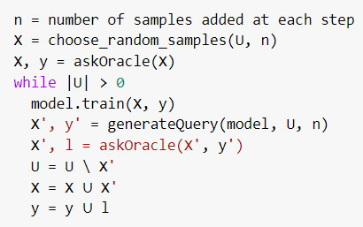
| Put it simply,...
U: unlabeled dataset
At the beginning of the process we randomly pick a few entries and we forward them to the human oracle to be labeled (askOracle).
Then, in generateQuery we use the model to predict labels for all of the samples that don’t have one yet

Slide 46
| Put it simply,...
Remember that we said earlier that the algorithm asks questions?: “Are y’ the correct labels for the entries in X’ ?”.
The corrected labels l are added to the set of known labels y and the samples X’ (the most informative) are added to X and removed from U.
The process continues until the model performs well enough or we end up without any unlabeled entries

Slide 47
| Notes
The oracle is a human annotator
The key idea behind active learning is that a machine learning algorithm can achieve greater accuracy with fewer training labels if it is allowed to choose the data from which it learns
Learner - The algorithm that may occasionally send questions to the oracle. It is not a person but an agent
How to calculate entropy?

Slide 49
| When to use active learning?
when you can annotate only a small fraction of your data and when random sampling will not cover the diversity of data
  when there is a shortage of labelled data
  This recommendation covers most real-world scenarios
A good example is the amount of data present in videos. Putting a bounding box around every object in every frame of a video
This video is of a self-driving car on a street with about 20 objects you care about (cars, pedestrians, signs, and so on).
  At 30 frames a second, that’s 30 frames * 60 seconds * 20 objects, so you would need to create 36,000 boxes for one minute of data!
Even the fastest human annotator would need at least 12 hours to annotate one minute’s worth of data

Slide 50
| When to use active learning?
In the United States, people drive an average of 1 hour per day, which means that people in the United States drive 95,104,400,000 hours per year. Soon, every car will have a video camera on the front to assist with driving.
So 1 year’s worth of driving in the United States alone would take 60,000,000,000 (60 trillion) hours to annotate.
There are not enough people on Earth to annotate the videos of drivers in the United States today, even if the rest of the world did nothing but annotate data all day to make U.S. drivers safer
You don’t need active learning in every situation, although human-in-the-loop learning strategies might still be relevant.
In some cases, humans are required by law to annotate every data point, such as a court-ordered audit that requires a human to look at every communication within a company for potential fraud

Slide 51
| Examples
Classification and Filtering: Learning to classify documents (e.g., articles or web pages) or any other kind of media (e.g., image, audio, and video files) usually requires people to annotate each item with particular labels: Relevant or not-Relevant. Unlabeled instances abound from electronic resources like the Internet, but annotating thousands of these instances can be tedious and even redundant

Slide 52
| Examples
Speech recognition:Accurate labeling of speech utterances is extremely time consuming and requires trained linguists. While unannotated audio data is easily obtained from recording devices, Zhu and Goldberg (2009) have reported that annotation at the word level can take ten times longer than the actual audio (e.g., one minute of speech takes ten minutes to label), and annotating phonemes can take 400 times as long (e.g., nearly seven hours). The problem is compounded for rare languages or dialects

Slide 53
| Examples
Information extraction. Systems that extract factual knowledge from text must be trained with detailed annotations of documents. Users highlight entities or relations of interest, such as person and organization names, or whether a person works for a particular organization. Locating entities and relations can take a half-hour or more for even simple newswire stories (Settles et al., 2008a).
Annotations for specific knowledge domains may require additional expertise, e.g., annotating gene and disease mentions in biomedical text usually requires PhD level biologists

Slide 55
| References
Active learning is motivated by the understanding that not all labeled examples are equally important
Introduction to Active Learning. What is Active Learning? | by Michelle Zhao
Active Learning: Your Model's New Personal Trainer | by ODSC - Open Data Science
https://medium.com/cognifeed/https-medium-com-cognifeed-a-short-introduction-to-active-learning-8c583c81f4e5
Guide to Active Learning in Machine Learning (ML)
https://medium.com/cognifeed/https-medium-com-cognifeed-a-short-introduction-to-active-learning-8c583c81f4e5

