Slide 1


Bio-inspired computation:
Good Practices, Challenges and Research Direction
Dr. Mostafa A. Elhosseini
Prof. at Taibah University
https://youtube.com/drmelhosseini

Slide 2
| Agenda
Intro
What is AI
  Machine Learning
  Deep Learning
Why Now?
Fusion of Bioinspired and Deep Learning
Bioinspired Optimization Algorithms
Good practices and Recommendations
What is the future direction of bioinspired

Slide 3
| Intro…
In the past few years, Artificial Intelligence (AI) has been a subject of intense media hype
We’re promised a future of intelligent chatbots, self-driving cars, and virtual assistants
  What has deep learning achieved so far?
  How significant is it?
  Where are we headed next?

Slide 4
| Intro…
In late 2015, Google CEO Sundar Pichai stated,
“Machine learning is a core, transformative way by which we’re rethinking how we’re doing everything. We’re thoughtfully applying it across all our products, be it search, ads, YouTube, or Play. And we’re in early days, but you’ll see us—in a systematic way— apply machine learning in all these areas”
Notes:
Sundar Pichai, Alphabet earnings call, Oct. 22, 2015

Slide 5
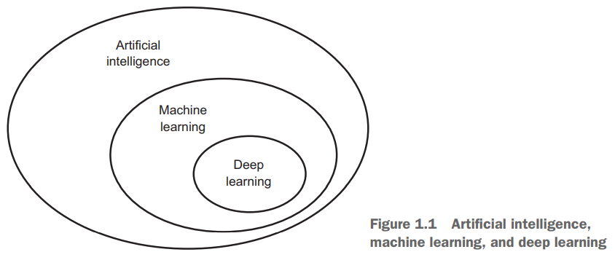
| Artificial Intelligence (AI)

Slide 6
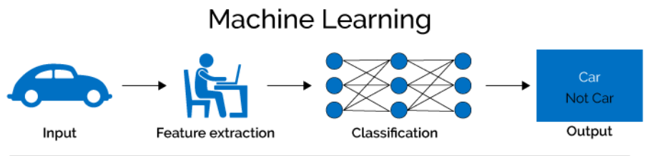
| Machine Learning
Machine Learning is the science (and art) of programming computers so they can learn from data
The field of study that gives computers the ability to learn without being explicitly programmed – Arthur Samuel, 1959
A computer program is said to learn from experience E with respect to some task T and some performance measure P, if its performance on T as measured by P, improves with experience E. Tom Mitchell, 1997

Slide 7
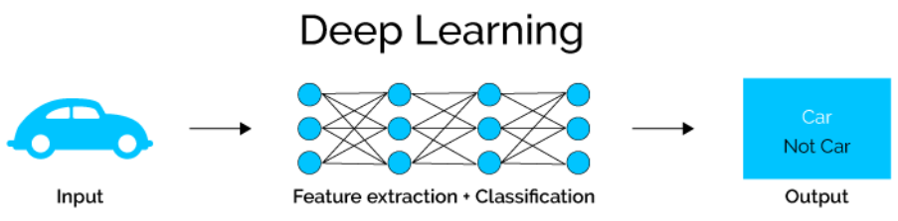
|Deep NN
Neural network can learn the best features and their contribution, they can perform feature engineering themselves
Partially replace the need for feature engineering, or manually create better predictive features
Deep learning also called → representation learning
You can think of a deep network as a multistage information-distillation operation, where information goes through successive filters and comes out increasingly purified (that is, useful with regard to some task)

Slide 8
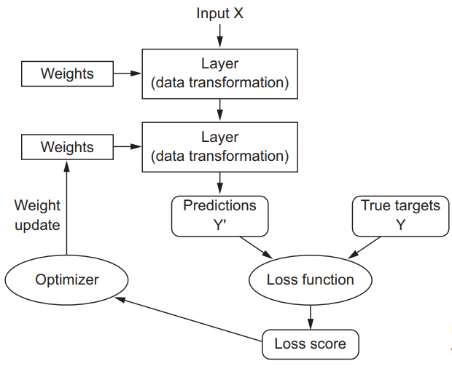
| How Does Deep Learning works?

Slide 9
| Why Now
A convergence of algorithmic advances, data proliferation, and tremendous increases in computing power and storage has propelled AI from Hype to reality
Data Explosion
Computing power and storage
A convergence of algorithmic advances
Transfer Learning
in large part due to a level of funding never seen before in the short history of AI

Slide 10
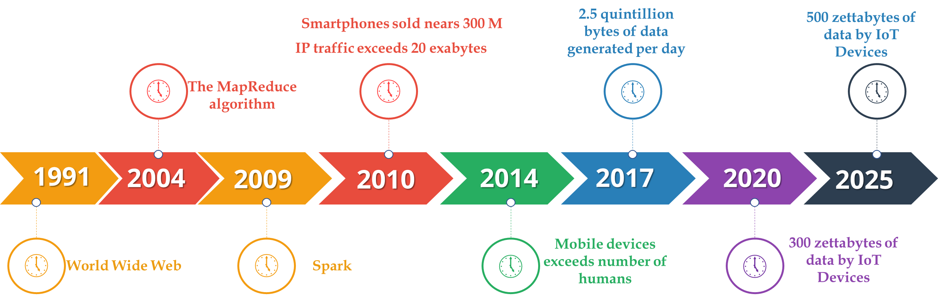
| Data Explosion

Slide 11
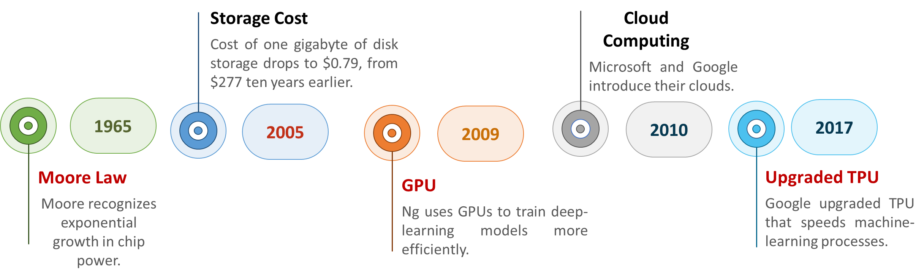
| Computing power and storage

Slide 12
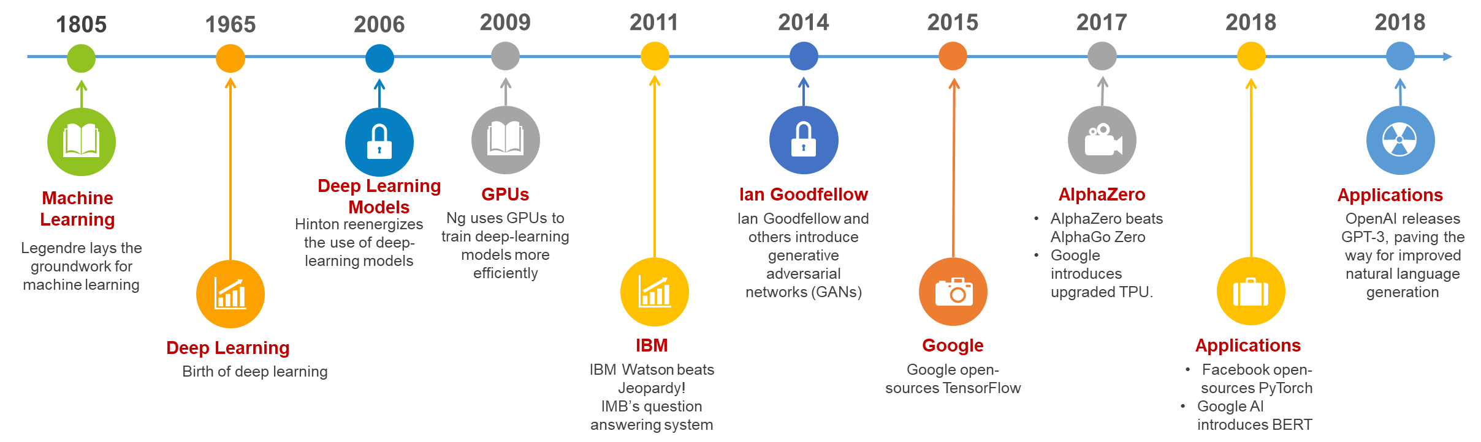
| A convergence of algorithmic advances

Slide 13
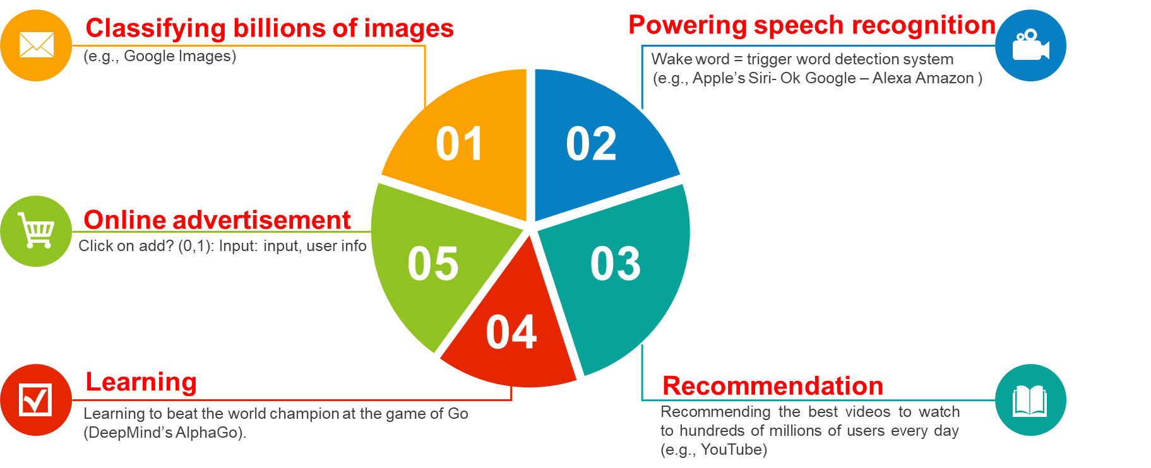
| Why all the hype about Deep NN?
Notes:
Local minima → horse

Slide 14
| Fusion of Bioinspired and Deep Learning
The architectural design, hyper-parameter tuning, and training of Deep Learning “as a replacement for gradient-based solvers” can be formulated as optimization problems has motivated a long story between these models and the field of bio-inspired optimization
The number of layers, their dimension and type of neurons, intermediate processing elements, and other structural parameters can span a large solution space demanding search heuristics for their efficient exploration. Similarly,
Notes:
Local minima → horse

Slide 15
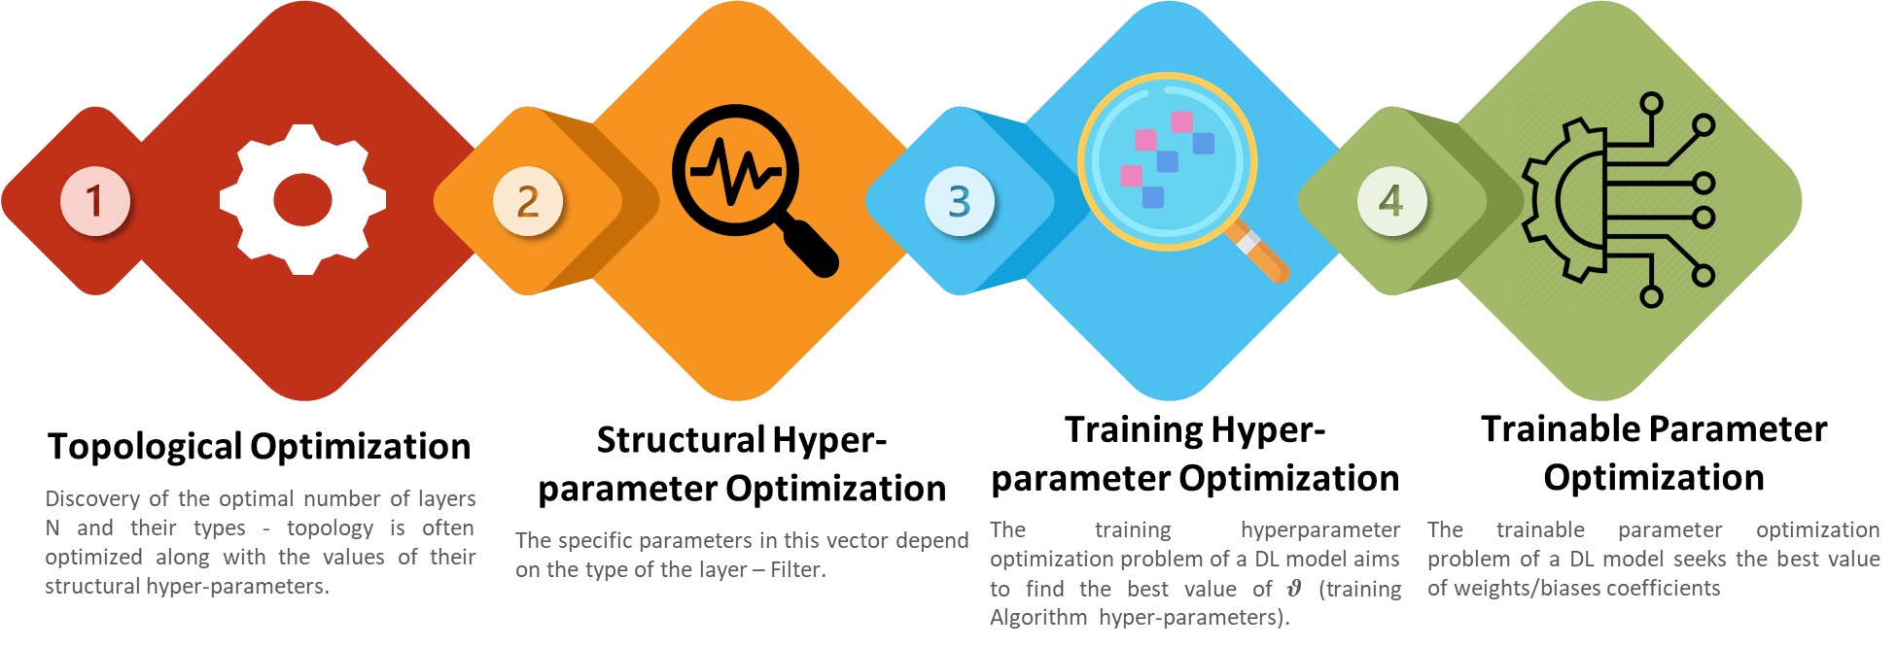
| Fusion of Bioinspired and Deep Learning
Notes:
Local minima → horse

Slide 16
| Fusion of Bioinspired and Deep Learning
The main scientific interest of this work and those published thereafter is to assess whether meta-heuristics can avoid the convergence limitations of gradient descent methods when facing strongly non-convex search spaces as those characterizing the problem of training complex Deep Learning architectures.
Nonetheless, most agreed on the dilated computation time and enormous computational resources needed by meta-heuristic solvers
Recently, this tendency is again emerging, stimulated by advances in highly parallel computing paradigms including GPU
Notes:
Local minima → horse

Slide 17
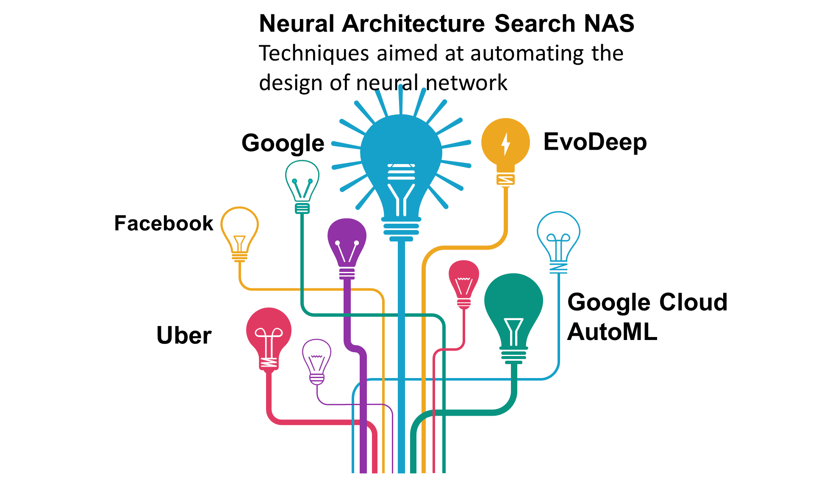
| Fusion of Bioinspired and Deep Learning
Notes:
Local minima → horse

Slide 18
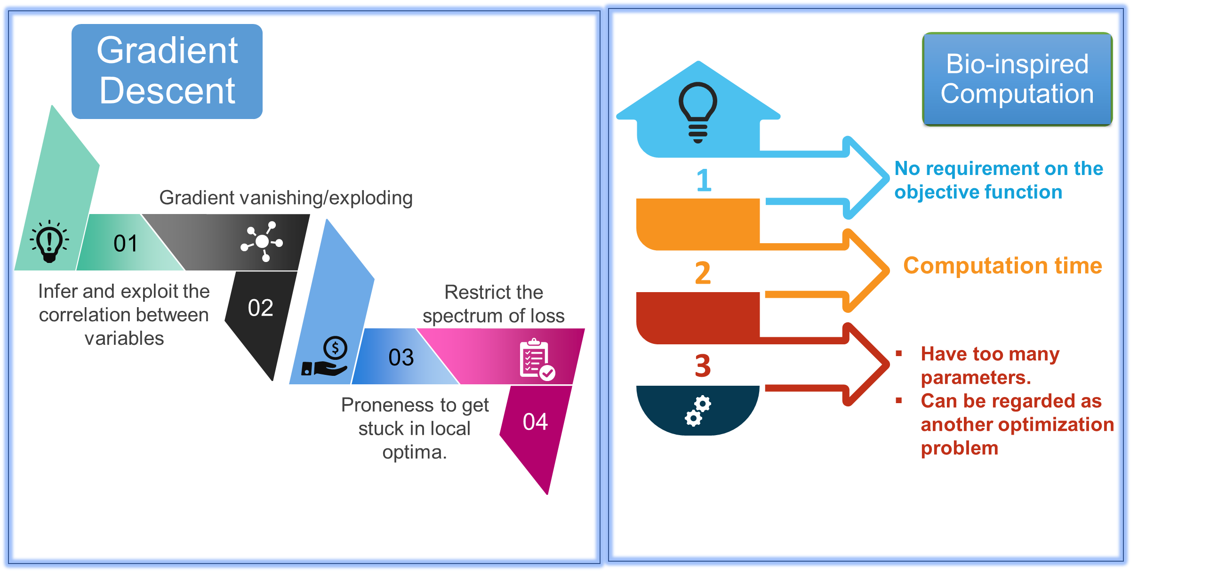
| Fusion of Bioinspired and Deep Learning
Notes:
Local minima → horse

Slide 19
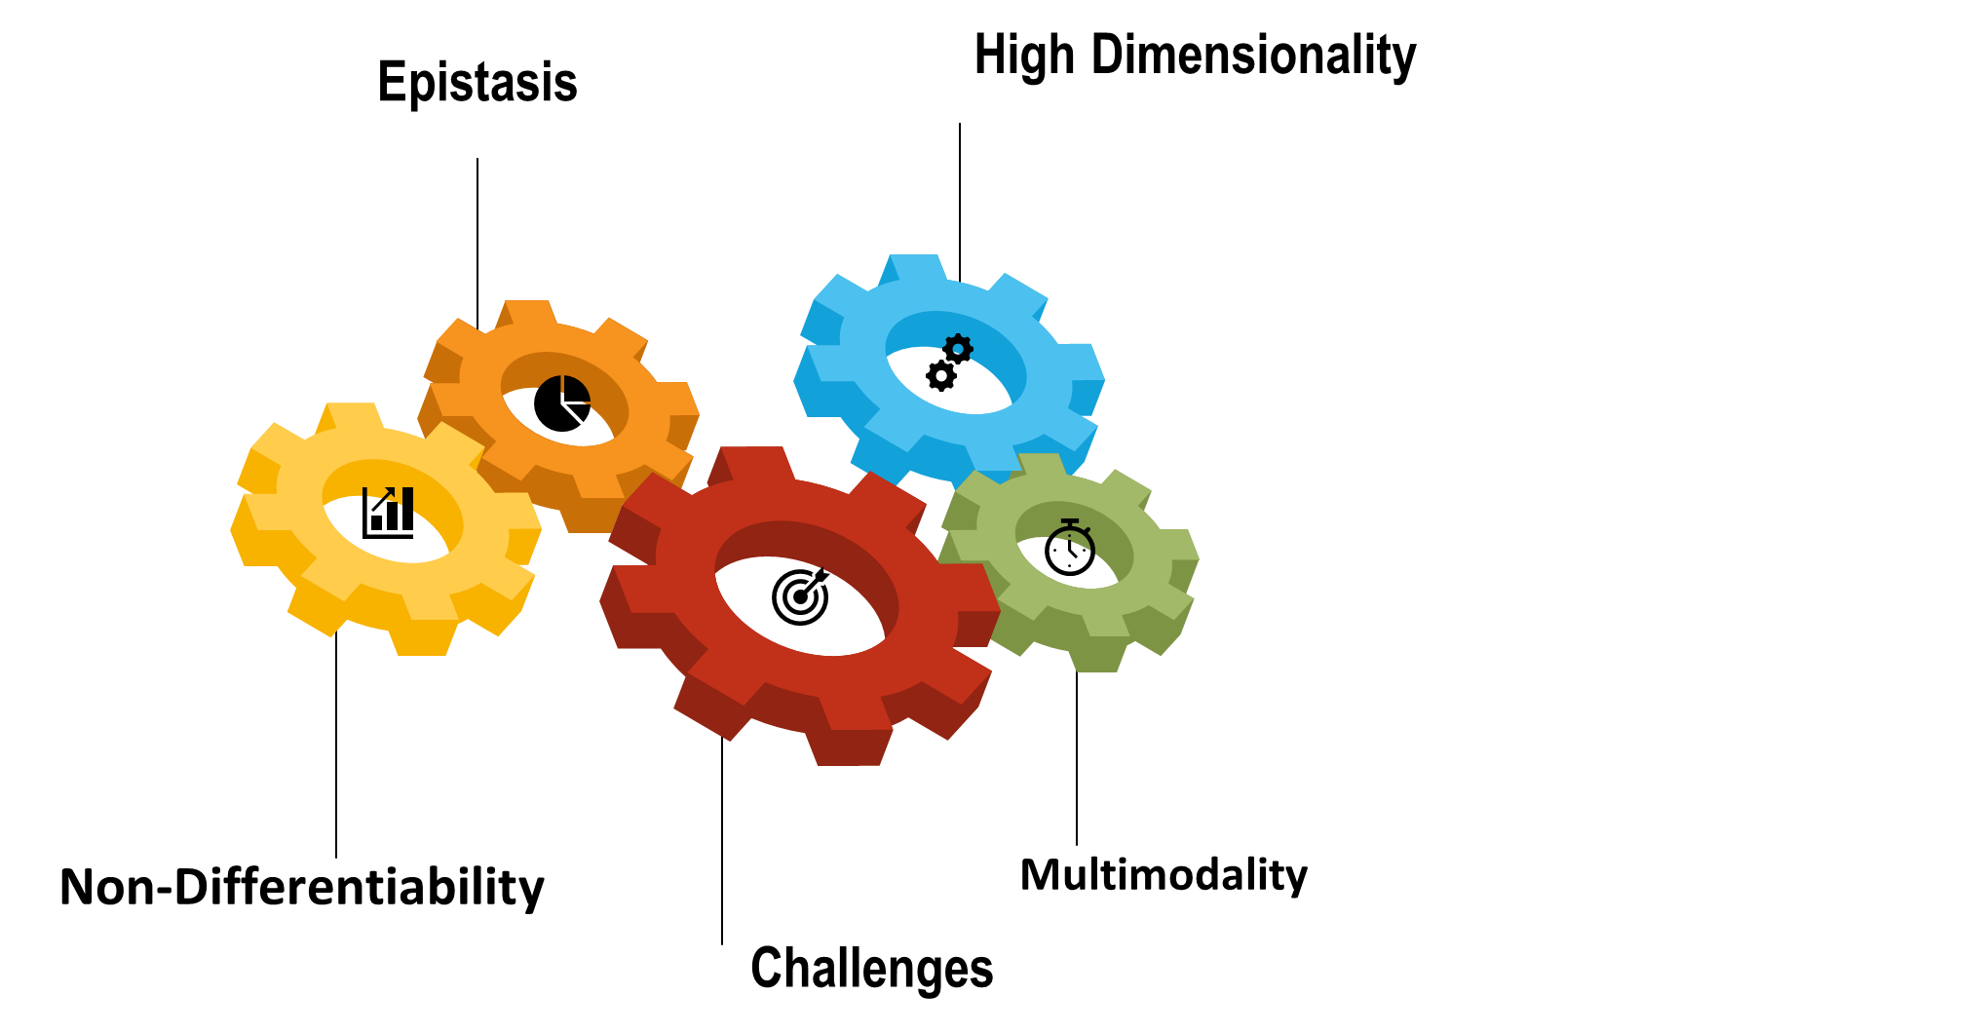
| Real-Life Optimization Problems
Notes:
Search and Optimization By Metaheuristics Techniques and Algorithms inspired by Nature

Slide 20
| Bioinspired Computation
Many real-life optimization problems are difficult to solve by exact optimization methods, due to properties, such as
  High dimensionality, Multimodality, Epistasis (parameter interaction), and
  Non-differentiability.
Notwithstanding this upsurge of activity,
  Research in this vibrant topic should be steered towards certain areas that,
  Despite their eventual value and impact on the field of bio-inspired computation, still remain insufficiently explored to date
Notes:
Search and Optimization By Metaheuristics Techniques and Algorithms inspired by Nature

Slide 21
| Why Bioinspired?
Adaptability, Self-learning, Flexibility, Randomness, Mutually balanced in Intensification and diversification, Intuitive guidelines, Robustness, and efficiency
To mimic the inherent advantages of such biological systems to address complex modeling, simulation, and optimization problems
Notes:
An Introduction to Harmony Search Optimization method
Metaheuristics for hard optimization

Slide 22
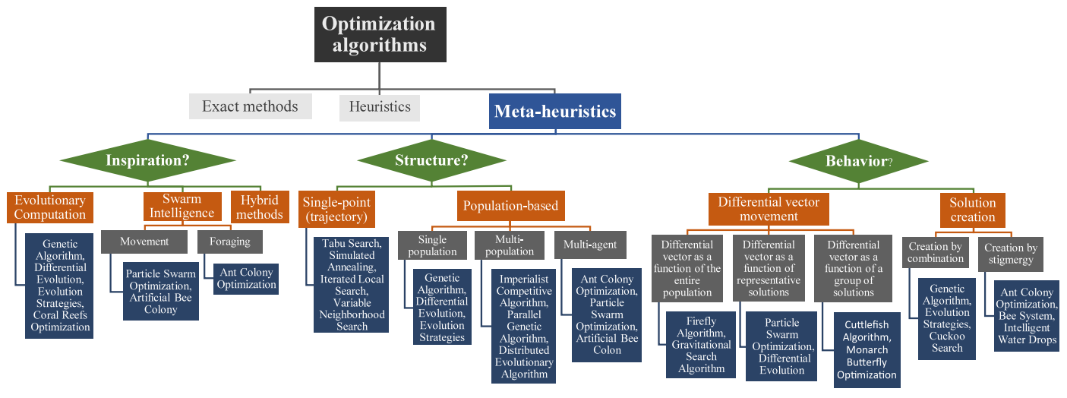
| Bioinspired Optimization Algorithms
Notes:
Bio-inspired computation: Where we stand and what’s next

Slide 23
| Where we stand….what is next?
Bio-inspired computation has emerged as one of the most studied branches of Artificial Intelligence
  Which research directions should be pursued in the future
  Provide an informed insight of the status of this field from both descriptive (where we stand) and prescriptive (what’s next) points of view
Notes:
Bio-inspired computation: Where we stand and what’s next

Slide 24
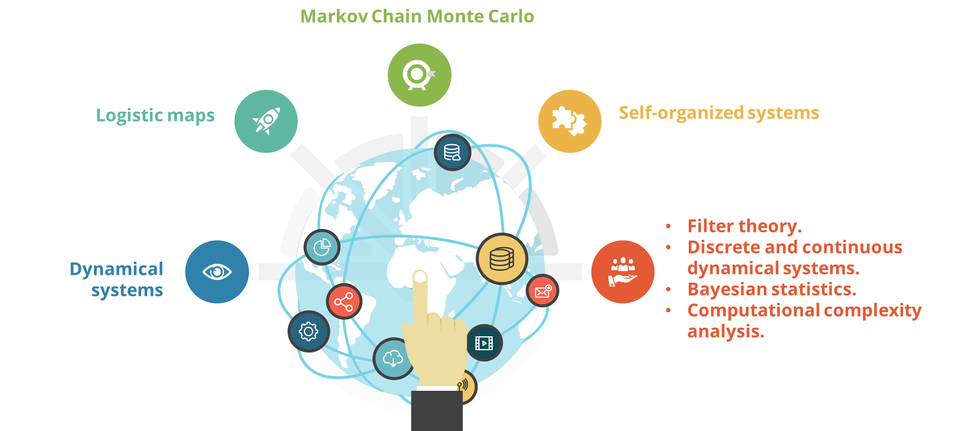
| Theoretical Foundation
Yield valuable information on the fundamental reasons why a search algorithm performs empirically better than others
Notes:
Bio-inspired computation: Where we stand and what’s next

Slide 25
| Theoretical Foundation
No Free Lunch Theorem
  No optimization algorithm can perform better than any other under any metric over all possible problems
  lack of a universally outperforming metaheuristic for all kinds of optimization problems
Notes:
Bio-inspired computation: Where we stand and what’s next

Slide 26
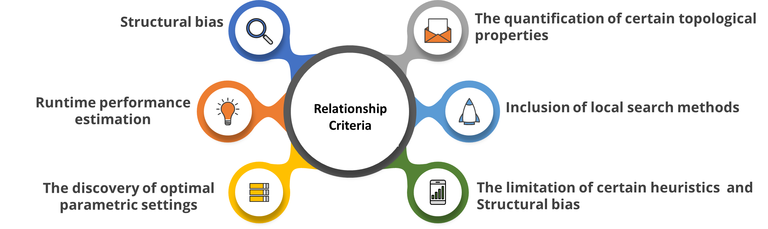
| Theoretical Foundation (Landscape Analysis)
Relationship between the solution space of the problem to be solved and the design of the bio-inspired optimization technique
Notes:
Bio-inspired computation: Where we stand and what’s next

Slide 27
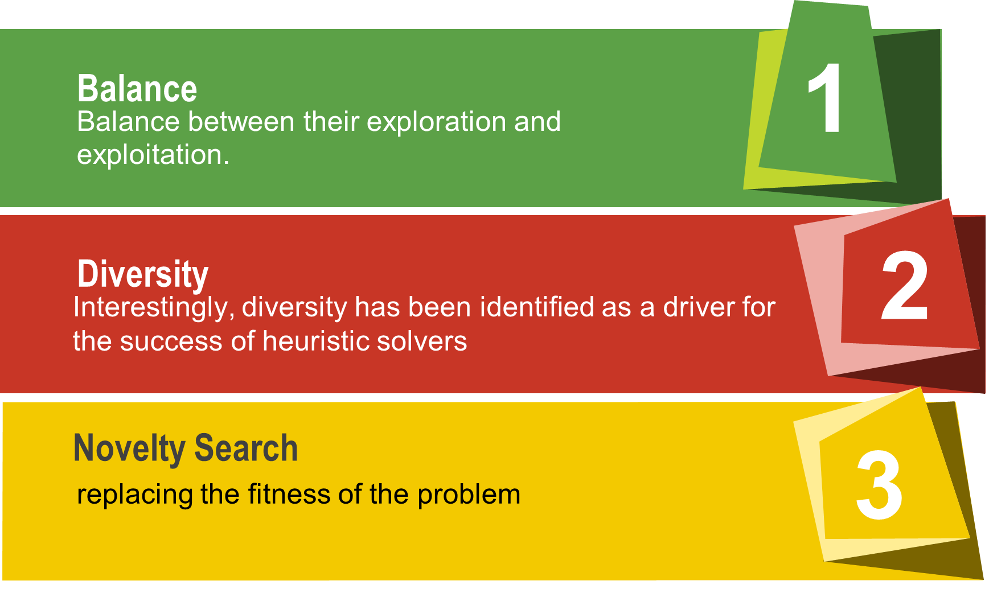
| Theoretical Foundation (Search Efficiency)
Notes:
An Introduction to Harmony Search Optimization Method
Bio-inspired computation: Where we stand and what’s next
Search and Optimization by metaheuristics Techniques and algorithms inspired by nature

Slide 28
| Dynamic and Stochastic optimization
Dynamic Optimization: Techniques tailored to efficiently undertake problems whose objectives and/or constraints may change along time
Stochastic optimization studies the development of solvers capable of dealing with uncertainty
Multimodal optimization problems consist of finding multiple optima solutions within a single algorithm run, in order to have a better knowledge about the different solutions in the search space.
The literature has been rich in regard to niching approaches that have been combined with bio-inspired heuristics in order to help them properly search over multimodal fitness landscapes: Fitness sharing, The clearing method, crowding schemes, Speciation and islanding, exploit the concept of neighborhood
Notes:
Bio-inspired computation: Where we stand and what’s next

Slide 29
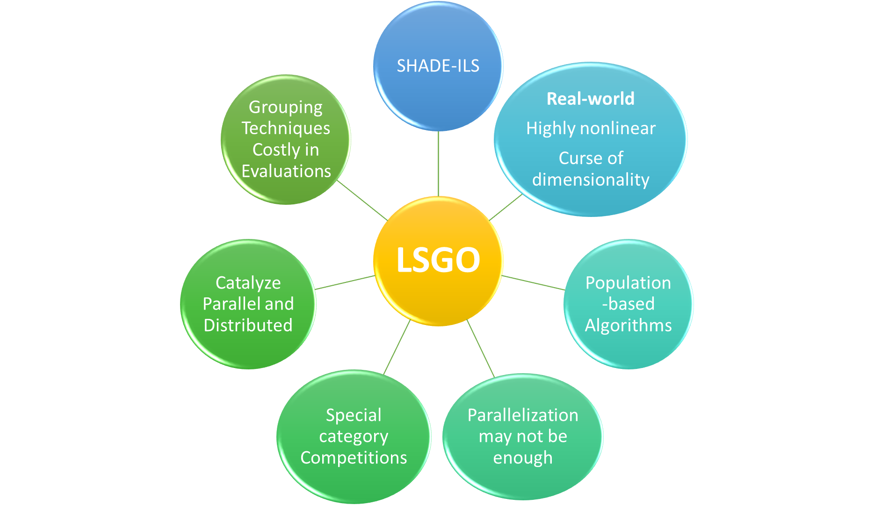
| Large-Scale Global Optimization (LSGO)
Notes:
Bio-inspired computation: Where we stand and what’s next

Slide 30
| Parameter Tuning
bio-inspired algorithms have too many parameters, so that seeking the best value for each one of them can be regarded as another optimization problem by itself
Deterministic “Tuning or off-line tuning” methods adapt parameters following deterministic rules, which are not dependent on any feedback.
Adaptive methods, parameters are adapted according to a feedback signal extracted from the controlled metaheuristic.
Self-adaptive “online tuning” methods encode the parameters of the metaheuristics alongside the parameters of the optimization problem in a single vector, which are evolved together during the optimization process itself
Notes:
Bio-inspired computation: Where we stand and what’s next

Slide 31
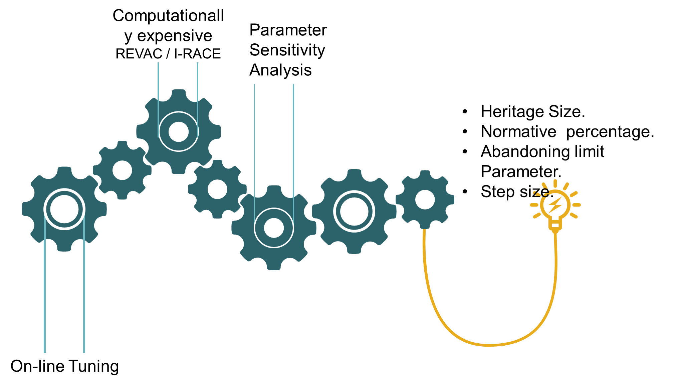
| Parameter Tuning
Notes:
de Lacerda, M.G.P., de Araujo Pessoa, L.F., de Lima Neto, F.B., Ludermir, T.B. and Kuchen, H., 2020. A systematic literature review on general parameter control for evolutionary and swarm-based algorithms. Swarm and Evolutionary Computation, p.100777.

Slide 32
| Parameter Adaptation
There are many proposals in GA to encourage diversity, such as an adaptive mutation or and adaptation of the selection mechanism to recombine the most dissimilar individuals
Another recent trend is to consider not only the best solution to guide the search, but a group of the best p solutions
In memetic algorithms or in co-evolutionary algorithms, in which several algorithms are used in combination, there are also parameters that control how these algorithms interact with each other.
The most widespread method is to select one algorithm based on a probability, which is periodically updated as a function of the relative improvement obtained by each component.
Notes:
Bio-inspired computation: Where we stand and what’s next
In memetic algorithms or in co-evolutionary algorithms, in which several algorithms are used in combination, there are also parameters that control how these algorithms interact with each other.

Slide 33
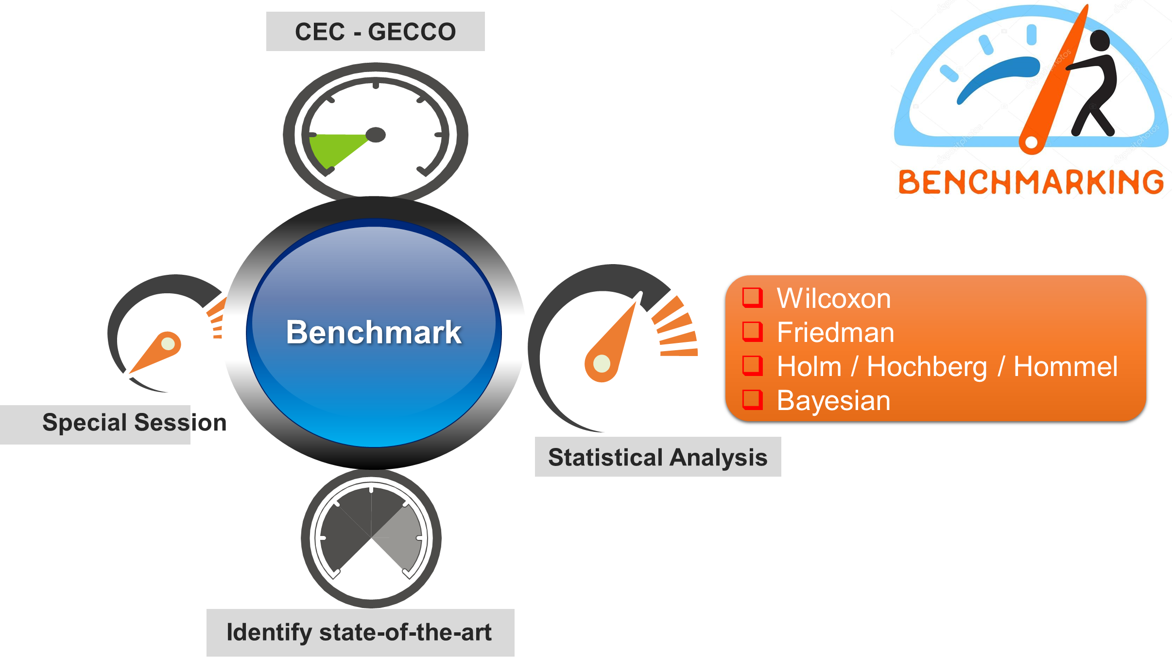
| Benchmarks & Comparison Methodologies
Notes:
Bio-inspired computation: Where we stand and what’s next

Slide 34
|Good practices and Recommendations
Lack of benchmark datasets/tasks
Unrealistic complexity of deep learning models
Comparisons should compulsorily include gradient back-propagation based solvers widely used for the same purpose (e.g. SGD, Adam).
The huge search space faced by the optimization algorithm under consideration requires intelligent means to exploit the relationships existing among the optimization variables
SHADE-ILS: A reference evolutionary algorithm for large-scale global optimization
Notes:
Local minima → horse

Slide 35
|Good practices and Recommendations
The assessment of the statistical significance is a must when dealing with problems related to Deep Learning
The goal in Evolutionary Deep Learning is to yield models of improved generalization properties
Quantitative evaluation of the complexity of the solver, not only a mere indication of the quality of its produced output.
global consensus on the dimensions of realistic benchmark dataset and models
we are far from fully replacing gradient-based solvers with bio-inspired optimization algorithms
Notes:
Local minima → horse

Slide 36
|Good practices and Recommendations
One of the most renowned and competitive algorithms for large-scale global optimization (SHADE-ILS) has not been able to perform better than the gradient-based Adam solver.
In summary, for the time being bio-inspired optimization algorithms cannot rival the computational efficiency and the quality of solutions produced by gradient-based methods
This suggests that more sophisticated hybridization strategies should be further investigated to embed problem-specific knowledge
Notes:
Local minima → horse

Slide 37
|Good practices and Recommendations
infer and exploit the correlation between variables during the search process (interaction learning ).
Another interesting research path stems from the adoption of niching methods used in bio-inspired algorithms for multi-modal problems for the construction of Deep Learning ensembles (also referred to as committees)
Notes:
Local minima → horse

Slide 38
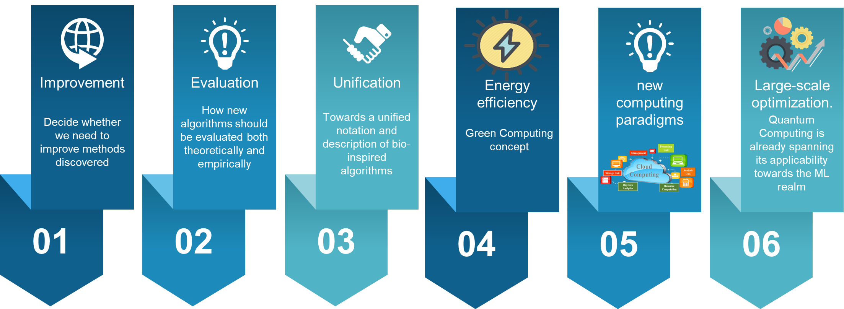
| Recommended Directions
Notes:
Bio-inspired computation: Where we stand and what’s next

Slide 39
| Recommended Directions
To decide whether we need to improve methods discovered so far by the community, or instead look for new biological sources of inspiration
Need a consensus on how new algorithms should be evaluated both theoretically (novelty, properties) and empirically (comparison methodologies, benchmark problems)
Towards a unified notation and description of bio-inspired algorithms
Nonetheless, there is an increasing global concern with energy efficiency, which has lately coined the so-called Green Computing concept
Notes:
Bio-inspired computation: Where we stand and what’s next

Slide 40
| Recommended Directions
The entire community should keep a close eye at the impending arrival of new computing paradigms, from the Map/Reduce model that lies underneath Big Data architectures to Ephemeral Computing, Exascale Computing and Quantum Computing
Yet still at its infancy, Quantum Computing is already spanning its applicability towards the ML realm and anticipating astonishing gains in terms of processing throughput for many other fields, including ML and large-scale optimization.
Notes:
Bio-inspired computation: Where we stand and what’s next
The entire community should keep a close eye at the impending arrival of new computing paradigms, from the Map/Reduce model that lies underneath Big Data architectures to Ephemeral Computing, Exascale Computing and Quantum Computing
Yet still at its infancy, Quantum Computing is already spanning its applicability towards the ML realm and anticipating astonishing gains in terms of processing throughput for many other fields, including ML and large-scale optimization.

Slide 41
| References
Hansen, N., Müller, S.D. and Koumoutsakos, P., 2003. Reducing the time complexity of the derandomized evolution strategy with covariance matrix adaptation (CMA-ES). Evolutionary computation, 11(1), pp.1-18.
Hussain, K., Salleh, M.N.M., Cheng, S. and Shi, Y., 2019. Metaheuristic research: a comprehensive survey. Artificial Intelligence Review, 52(4), pp.2191-2233.
Joyce, T. and Herrmann, J.M., 2018. A review of no free lunch theorems, and their implications for metaheuristic optimisation. Nature-inspired algorithms and applied optimization, pp.27-51.
Yang, X.S., 2018. Mathematical analysis of nature-inspired algorithms. In Nature-inspired algorithms and applied optimization (pp. 1-25). Springer, Cham.
Wang, M., Li, B., Zhang, G. and Yao, X., 2017. Population evolvability: Dynamic fitness landscape analysis for population-based metaheuristic algorithms. IEEE Transactions on Evolutionary Computation, 22(4), pp.550-563.
Lu, H., Zhou, R., Fei, Z. and Guan, C., 2019. Spatial-domain fitness landscape analysis for combinatorial optimization. Information Sciences, 472, pp.126-144.
Piotrowski, A.P. and Napiorkowski, J.J., 2018. Some metaheuristics should be simplified. Information Sciences, 427, pp.32-62.
Jiang, S., Yang, S., Yao, X., Tan, K.C., Kaiser, M. and Krasnogor, N., 2018. Benchmark Functions for the CEC'2018 Competition on Dynamic Multiobjective Optimization. Newcastle University.
Notes:
Bio-inspired computation: Where we stand and what’s next

Slide 42
| References
Ma, H., Shen, S., Yu, M., Yang, Z., Fei, M. and Zhou, H., 2019. Multi-population techniques in nature inspired optimization algorithms: A comprehensive survey. Swarm and evolutionary computation, 44, pp.365-387.
Yanıkoğlu, İ., Gorissen, B.L. and den Hertog, D., 2019. A survey of adjustable robust optimization. European Journal of Operational Research, 277(3), pp.799-813.
Wu, G., Mallipeddi, R. and Suganthan, P.N., 2019. Ensemble strategies for population-based optimization algorithms–A survey. Swarm and evolutionary computation, 44, pp.695-711.
Molina, D., LaTorre, A. and Herrera, F., 2018, July. SHADE with iterative local search for large-scale global optimization. In 2018 IEEE congress on evolutionary computation (CEC) (pp. 1-8). IEEE.
Molina, D., LaTorre, A. and Herrera, F., 2018. An insight into bio-inspired and evolutionary algorithms for global optimization: review, analysis, and lessons learnt over a decade of competitions. Cognitive Computation, 10(4), pp.517-544.
Notes:
Bio-inspired computation: Where we stand and what’s next

Slide 43
| References
Fong, S., Deb, S. and Yang, X.S., 2018. How meta-heuristic algorithms contribute to deep learning in the hype of big data analytics. In Progress in intelligent computing techniques: theory, practice, and applications (pp. 3-25). Springer, Singapore.
Arrieta, A.B., Díaz-Rodríguez, N., Del Ser, J., Bennetot, A., Tabik, S., Barbado, A., García, S., Gil-López, S., Molina, D., Benjamins, R. and Chatila, R., 2020. Explainable Artificial Intelligence (XAI): Concepts, taxonomies, opportunities and challenges toward responsible AI. Information Fusion, 58, pp.82-115.
Miikkulainen, R., Liang, J., Meyerson, E., Rawal, A., Fink, D., Francon, O., Raju, B., Shahrzad, H., Navruzyan, A., Duffy, N. and Hodjat, B., 2019. Evolving deep neural networks. In Artificial intelligence in the age of neural networks and brain computing (pp. 293-312). Academic Press.
Assunção, F., Lourenço, N., Machado, P. and Ribeiro, B., 2019. DENSER: deep evolutionary network structured representation. Genetic Programming and Evolvable Machines, 20(1), pp.5-35.
Chollet, F., 2018. Deep learning with Python (Vol. 361). New York: Manning.
Géron, A., 2019. Hands-on machine learning with Scikit-Learn, Keras, and TensorFlow: Concepts, tools, and techniques to build intelligent systems. O'Reilly Media.
Del Ser, J., Osaba, E., Molina, D., Yang, X.S., Salcedo-Sanz, S., Camacho, D., Das, S., Suganthan, P.N., Coello, C.A.C. and Herrera, F., 2019. Bio-inspired computation: Where we stand and what's next. Swarm and Evolutionary Computation, 48, pp.220-250.
Martinez, A.D., Del Ser, J., Villar-Rodriguez, E., Osaba, E., Poyatos, J., Tabik, S., Molina, D. and Herrera, F., 2021. Lights and shadows in Evolutionary Deep Learning: Taxonomy, critical methodological analysis, cases of study, learned lessons, recommendations and challenges. Information Fusion, 67, pp.161-194.
Notes:
Bio-inspired computation: Where we stand and what’s next

