Slide 1
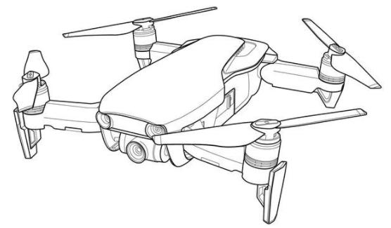
Drone Flight time calculator
Dr. Mostafa Elhosseini
Professor at Mansoura University
melhosseini@gmail.com

Slide 2
| Intro…
Drone flight time calculator lets you experiment with relevant parameters to find the best combination for your drone

Slide 3
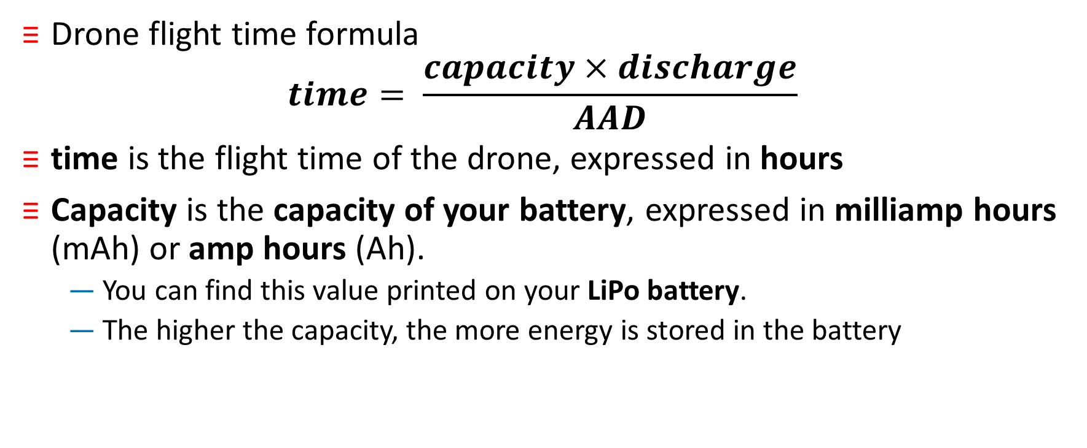
| Drone flight time formula
Drone flight time formula
$$time= \frac{capacity×discharge}{AAD}$$
time is the flight time of the drone, expressed in hours
Capacity is the capacity of your battery, expressed in milliamp hours (mAh) or amp hours (Ah).
  You can find this value printed on your LiPo battery.
  The higher the capacity, the more energy is stored in the battery

Slide 4
| Lithium-ion polymer battery (LiPo)
LiPo is a rechargeable battery of lithium-ion technology using a polymer electrolyte instead of a liquid electrolyte.
High conductivity semisolid (gel) polymers form this electrolyte.
These batteries provide higher specific energy than other lithium battery types and are used in applications where weight is a critical feature, such as mobile devices, radio-controlled aircraft and some electric vehicles

Slide 5
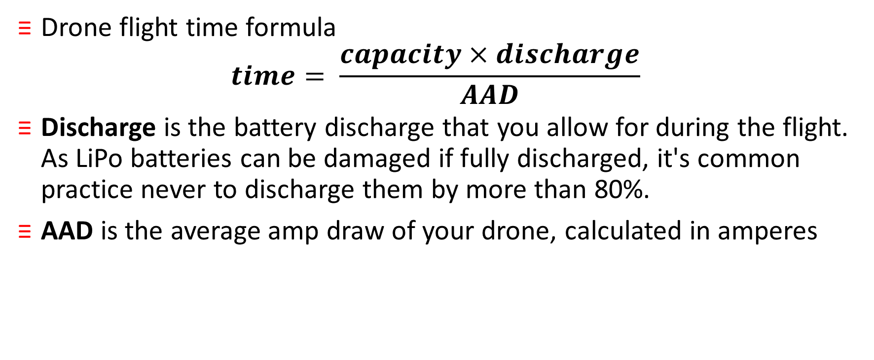
| Drone flight time formula
Drone flight time formula
$$time= \frac{capacity×discharge}{AAD}$$
Discharge is the battery discharge that you allow for during the flight. As LiPo batteries can be damaged if fully discharged, it's common practice never to discharge them by more than 80%.
AAD is the average amp draw of your drone, calculated in amperes

Slide 6
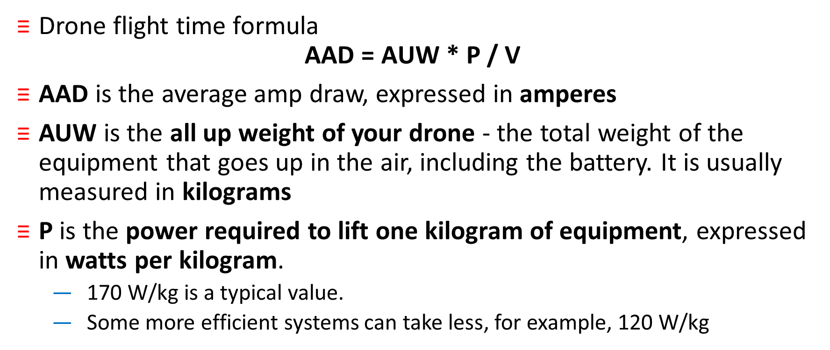
|How to calculate the amp draw?
Drone flight time formula
$$\text{AAD}\text{ = }\text{AUW}\text{ ∗ }\text{P}\text{ / }\text{V}$$
AAD is the average amp draw, expressed in amperes
AUW is the all up weight of your drone - the total weight of the equipment that goes up in the air, including the battery. It is usually measured in kilograms
P is the power required to lift one kilogram of equipment, expressed in watts per kilogram.
  170 W/kg is a typical value.
  Some more efficient systems can take less, for example, 120 W/kg

Slide 7
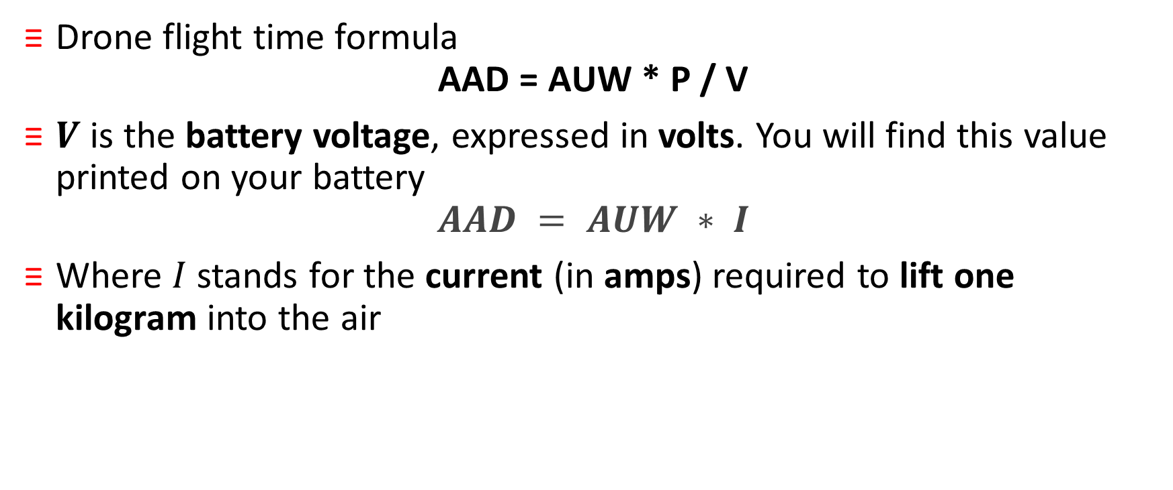
|How to calculate the amp draw?
Drone flight time formula
$$\text{AAD}\text{ = }\text{AUW}\text{ ∗ }\text{P}\text{ / }\text{V}$$
$V$ is the battery voltage, expressed in volts. You will find this value printed on your battery
$$AAD = AUW ∗ I$$
Where $I$ stands for the current (in amps) required to lift one kilogram into the air

Slide 8
| Example
you want your drone to hover in the air for thirty minutes to take an aerial video. Will an 8.8 Ah battery be suitable for this job?
Given that:
  Maximum discharge of the battery 80%
  Battery voltage = 36 V
  Drone with LiPo battery weighs 2.5 kg
  power required to lift one kilogram of equipment is 170 W/kg

Slide 9
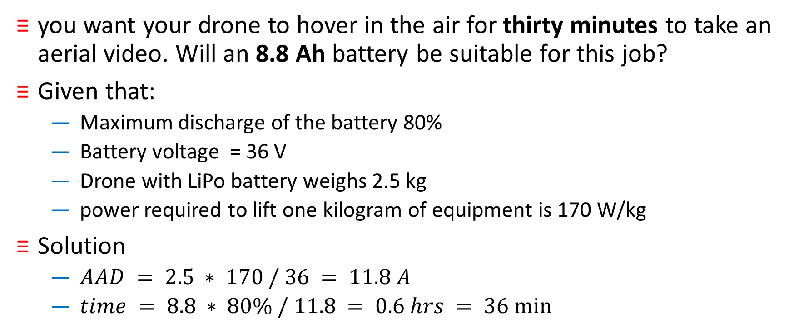
| Example
you want your drone to hover in the air for thirty minutes to take an aerial video. Will an 8.8 Ah battery be suitable for this job?
Given that:
  Maximum discharge of the battery 80%
  Battery voltage = 36 V
  Drone with LiPo battery weighs 2.5 kg
  power required to lift one kilogram of equipment is 170 W/kg
Solution
  $AAD = 2.5 ∗ 170 / 36 = 11.8 A$
  $time = 8.8 ∗ 80\% / 11.8 = 0.6 hrs = 36 min⁡$

Slide 10
| Various flying modes
Time calculated with these equations might differ from the real flight time.
We assume that your drone mostly hovers in the air - every time it performs some elaborate maneuvers, one of the motors has to work faster and hence uses up more current
If your drone only moves around slightly - for example, during aerial photography - the flight time will be about 75% of the calculated time

Slide 11
| Various flying modes
If your drone flies in strong wind or moves around a lot, the flight time will decrease to around 50%
If you're participating in FPV racing or flying at high throttle levels, the flight time will decrease to 25-30% of the calculated value
You must always keep your drone within your visual line-of-sight. This means you can see the drone with your own eyes, rather than through an electronic device, video screen or goggles

Slide 12
| Various flying modes
First Person View (FPV)
  Flying First Person View (FPV) makes use of an onboard camera that relays live video to goggles, mobile phone or tablet screen.
  When you fly FPV, you can only see vision from the onboard camera. Flying FPV limits your situational awareness and may lead to disorientation.
  Flying FPV increases the risk of the drone colliding with trees, people, birds or even other aircraft.
  Without situational awareness, you may not be able to manoeuvre the drone in time to prevent a collision

Slide 13
| References
Drone Flight Time Calculator By Bogna Szyk
https://www.omnicalculator.com/other/drone-flight-time
https://www.casa.gov.au/drones/rules/first-person-view

