Slide 1
The Art and Science of Systematic Reviews
| Academic Research
Prof. Dr. Mostafa Elhosseini
https://youtube.com/drmelhosseini

Slide 2
|Agenda
What is a systematic review?
Why are systematic reviews crucial in academic research?
Difference between systematic reviews and traditional literature reviews
Why you need a protocol before starting?
Registering your review (e.g., PROSPERO)?
Components of a Systematic Review Protocol
Preferred Reporting Items for Systematic Reviews and Meta-Analyses PRISMA
Systematic Reviews as Use Caes

Slide 3
|Introduction
What is a systematic review?
Why are systematic reviews crucial in academic research?
Difference between systematic reviews and traditional literature reviews

Slide 4
|What is a systematic review?
A systematic review is a research method that aims to collate and summarize all the available research evidence on a specific topic.
It is a rigorous and transparent process that follows a set of steps to identify, appraise, and synthesize the evidence.

Slide 5
|What is a systematic review?
The process involves:
  Defining a clear research question.
  Developing a protocol that outlines the methods to be used.
  Conducting a comprehensive literature search in multiple databases to identify relevant studies - This search should be comprehensive and unbiased, and it should be documented so that it can be replicated by others
  Screening the studies - Selecting studies based on predefined criteria.
  Appraising the studies - Assessing the quality of the included studies.
  Extracting and synthesizing data from the studies.
  Drawing conclusions based on the evidence.

Slide 6
|Why systematic reviews?
Evidence Synthesis: They provide a comprehensive summary of the existing literature on a specific topic, allowing researchers to understand the current state of knowledge.
Informed Decision-making: For professionals and policymakers, systematic reviews offer evidence-based insights that can guide decisions in healthcare, education, and other sectors.
Identifying Research Gaps: By synthesizing all known evidence, systematic reviews can highlight areas where further research is needed.
Reducing Redundancy: They prevent unnecessary duplication of research efforts by providing clear insights into what is already known.
High Credibility: Due to their rigorous methodology, systematic reviews are often considered a high level of evidence in the research hierarchy.

Slide 7
|Systematic reviews - Literature reviews
Methodology
  Systematic Review: Follows a strict and predefined protocol, ensuring transparency and reproducibility. Every step, from the literature search to data extraction, is systematic and explicit.
  Traditional Literature Review: Often lacks a strict protocol. The approach might be more subjective, and the methods are not always explicitly stated.

Slide 8
|Systematic reviews - Literature reviews
Purpose
  Systematic Review: To answer a specific research question by synthesizing all relevant evidence.
  Traditional Literature Review: To provide a general overview of a topic, often without a specific research question in mind.

Slide 9
|Systematic reviews - Literature reviews
Scope
  Systematic Review: Comprehensive and includes all relevant studies on a topic.
  Traditional Literature Review: May be selective, including only a subset of studies or those deemed most relevant by the author.

Slide 10
|Systematic reviews - Literature reviews
Bias
  Systematic Review: Aims to minimize bias through rigorous methodology.
  Traditional Literature Review: More prone to bias as the selection and interpretation of studies might be influenced by the author's perspective.

Slide 11
|Systematic reviews - Literature reviews
Update Frequency
  Systematic Review: Often updated to incorporate new evidence.
  Traditional Literature Review: Typically not updated regularly.

Slide 12
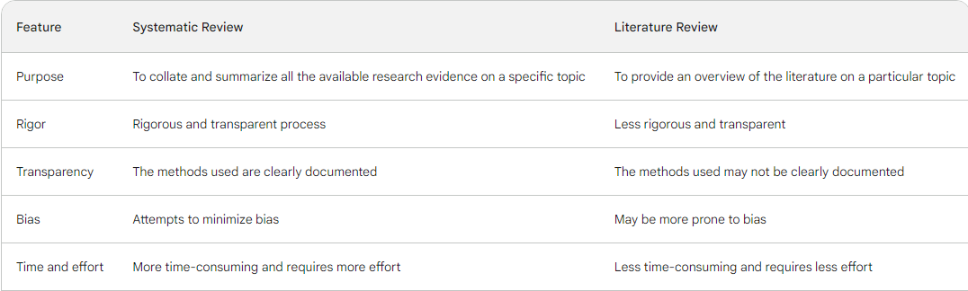
|Systematic reviews - Literature reviews

Slide 13
|Why you need a protocol before starting?
A protocol for a systematic review serves as a detailed plan that outlines the methods and procedures the researchers will follow. Here's why it's essential:
  Transparency: A protocol ensures that the review process is transparent. It allows others to understand the steps taken and the decisions made during the review.
  Consistency: It provides a clear roadmap for the researchers, ensuring that they remain consistent in their approach throughout the review.
  Reducing Bias: By pre-specifying the methods and criteria, the protocol helps reduce the risk of bias. It prevents post-hoc decisions that might be influenced by the results of the studies found.
  Avoiding Duplication: A protocol can help avoid unintentional duplication of efforts. Other researchers can see what reviews are underway and decide if they need to start a similar review.
  Enhancing Quality: Adhering to a protocol can enhance the overall quality and reliability of the systematic review.

Slide 14
|Registering your review (e.g., PROSPERO)?
Submitting the protocol to a publicly accessible database.
One of the most well-known databases for this purpose is PROSPERO (International Prospective Register of Systematic Reviews).
  Purpose: Registration aims to promote transparency, reduce duplication, and prevent outcome reporting bias (where only certain results are reported based on the findings).
  Visibility: Once registered, the review protocol becomes publicly available, allowing others in the research community to be aware of ongoing reviews.
  Accountability: Registration holds researchers accountable to follow their pre-specified methods, reducing the temptation to modify the protocol based on the studies' results.

Slide 15
|Registering your review (e.g., PROSPERO)?
PROSPERO is the International Prospective Register of Systematic Reviews (PROSPERO). It is an open access online database of systematic review protocols on a wide range of topics.
PROSPERO was created in 2007 by the Centre for Reviews and Dissemination (CRD) at the University of York in England. It is funded by the National Institute for Health Research (NIHR).
PROSPERO is a valuable resource for researchers, policymakers, and the public. It can be used to find out about systematic reviews that are currently being conducted, and to see the results of completed reviews.
To register a systematic review protocol with PROSPERO, researchers must complete an online form. The form asks for information about the research question, the methods that will be used, and the expected timeline for the review.
Once a protocol has been registered with PROSPERO, it is assigned a unique identifier. This identifier can be used to track the progress of the review and to access the final report when it is published.
PROSPERO is an important tool for ensuring the quality and transparency of systematic reviews. It helps to ensure that reviews are conducted in a rigorous and systematic way, and that the results are accessible to the public.

Slide 16
|Registering your review (e.g., PROSPERO)?
Here are some of the benefits of registering a systematic review protocol with PROSPERO:
  It helps to ensure that the review is conducted in a rigorous and systematic way.
  It makes the review more transparent and accessible to the public.
  It can help to avoid duplication of effort.
  It can help to identify gaps in the literature.
  It can help to promote collaboration between researchers.

Slide 17
|Components of a Systematic Review Protocol
Objectives: Clearly state the purpose of the review. What research question(s) are you aiming to answer?
Eligibility Criteria: Define which studies will be included or excluded based on:
  Types of participants (e.g., age, condition, demographic).
  Types of interventions (if applicable).
  Types of comparators (if applicable).
  Types of outcomes (primary and secondary outcomes of interest).
  Study design (e.g., randomized controlled trials, observational studies).
Search Strategy: Detail how you will search for studies:
  Databases to be searched (e.g., PubMed, Scopus).

Slide 18
|Components of a Systematic Review Protocol
  Search terms and combinations.
  Time period for the search.
  Language restrictions, if any.
Methods of Analysis: Describe how you will synthesize and analyze the data:
  Data extraction process (e.g., which data will be extracted from each study).
  Quality assessment tools or scales to be used.
  Statistical methods for meta-analysis, if applicable.
  Methods to assess heterogeneity among studies.
  Plans for subgroup or sensitivity analyses, if applicable.

Slide 19
|Components of a Systematic Review Protocol
  Search terms and combinations.
  Time period for the search.
  Language restrictions, if any.
Methods of Analysis: Describe how you will synthesize and analyze the data:
  Data extraction process (e.g., which data will be extracted from each study).
  Quality assessment tools or scales to be used.
  Statistical methods for meta-analysis, if applicable.
  Methods to assess heterogeneity among studies.
  Plans for subgroup or sensitivity analyses, if applicable.

Slide 20
|PRISMA
PRISMA stands for Preferred Reporting Items for Systematic Reviews and Meta-Analyses. It is a set of guidelines for reporting systematic reviews and meta-analyses. The PRISMA flow diagram is a graphical representation of the process of conducting a systematic review. It is used to visualize the flow of information through the different phases of the review, from the identification of studies to the final selection of studies for inclusion.
The PRISMA flow diagram has four phases:
Identification: This phase includes the search for studies, the screening of titles and abstracts, and the retrieval of full-text articles.
Screening: This phase involves assessing the full-text articles to determine if they meet the inclusion criteria for the review.
Eligibility: This phase involves making a final decision about whether or not to include each study in the review.
Data extraction: This phase involves extracting data from the included studies.

Slide 21
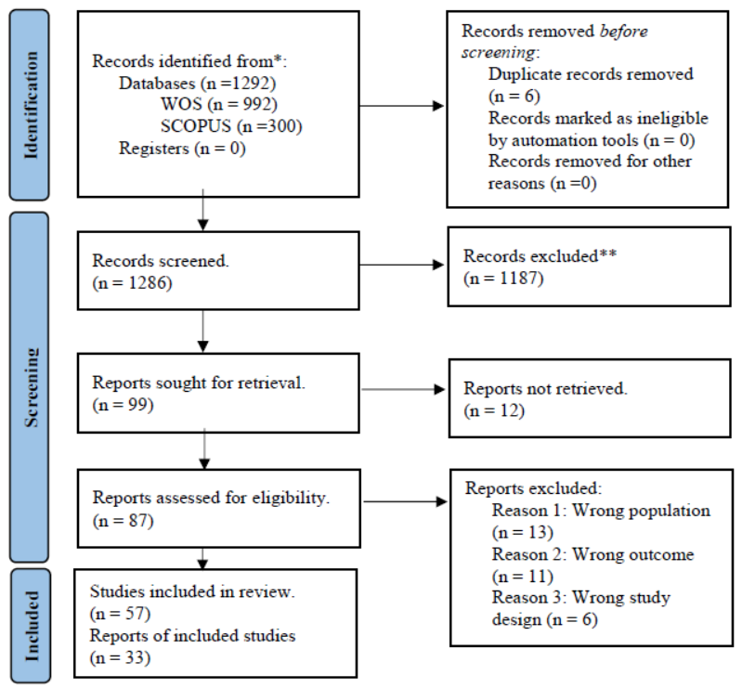
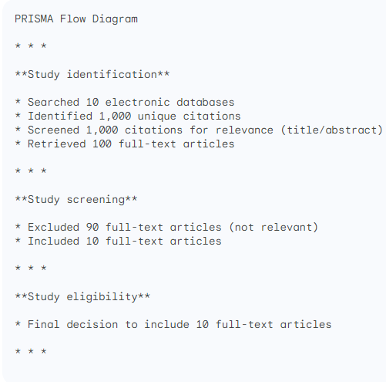
|PRISMA

Slide 22
|Examples
Groen, A.M., Kraan, R., Amirkhan, S.F., Daams, J.G. and Maas, M., 2022. A systematic review on the use of explainability in deep learning systems for computer aided diagnosis in radiology: Limited use of explainable AI?. European Journal of Radiology, p.110592.
Memarian, B. and Doleck, T., 2023. Fairness, Accountability, Transparency, and Ethics (FATE) in Artificial Intelligence (AI), and higher education: A systematic review. Computers and Education: Artificial Intelligence, p.100152.
Iftikhar, S., Gill, S.S., Song, C., Xu, M., Aslanpour, M.S., Toosi, A.N., Du, J., Wu, H., Ghosh, S., Chowdhury, D. and Golec, M., 2022. AI-based fog and edge computing: A systematic review, taxonomy and future directions. Internet of Things, p.100674.
Liu, X., Jiang, D., Tao, B., Xiang, F., Jiang, G., Sun, Y., Kong, J. and Li, G., 2023. A systematic review of digital twin about physical entities, virtual models, twin data, and applications. Advanced Engineering Informatics, 55, p.101876.

Slide 23
|Thank You

